Slide 1
Your Opportunity.
Your Freedom.

Slide 2
The World has Forever Changed
We are in a “work from anywhere” revolution
More income
More Time
More Flexibility
Independence
In these uncertain times, doesn’t it make sense to have a backup plan?

Slide 3
Are you working for the right kind of income?
3 forms of income
Linear income – trading time for money
Leveraged income – work with team, unlimited income potential
Residual income – your retirement plan

Slide 4
5 Areas to Evaluate
The company
The need in the marketplace
The product
The compensation
The timing

Slide 5
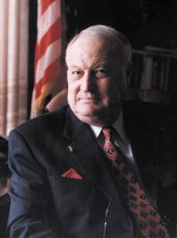
Established in 1972
Protecting & Empowering approximately 4.4 million lives in the U.S. & Canada. With a dedicated network of quality law firms in all 50 states and all Canadian provinces.
Our Vision
To provide EQUAL ACCESS to LIBERTY, EQUALITY, OPPORTUNITY & JUSTICE that every human deserves.

Slide 6
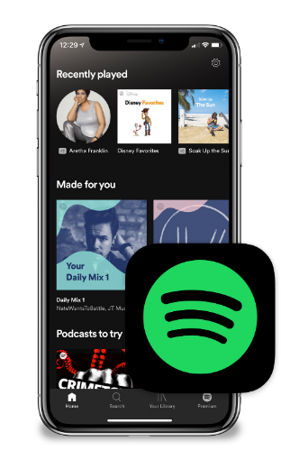
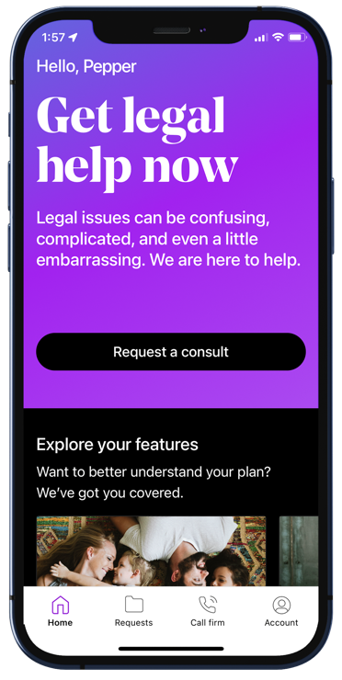
Disruptive Innovation Simpler. Easier. More Affordable.
WHAT ABOUT GETTING
ACCESS TO THE
JUSTICE SYSTEM?
REMEMBER
SHOPPING AT THE MALL?
OR
BUYING
CDs?

Slide 7
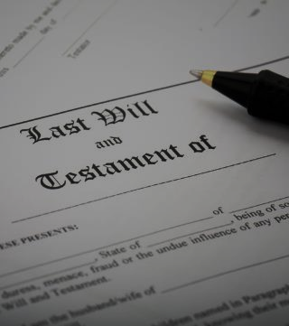
The Need for LegalShield
Uncertain times require preparation.

Slide 8
Have You Ever…
Thought about writing or revising your Will?
Lost a job and wanted to know your rights?
Been treated unfairly or said, “Let me speak to your supervisor”?
Been a victim of a breach or Identity theft?
Signed a contract you didn’t understand or regretted later?
Received a speeding ticket?
Had an insurance claim denied that you thought was covered?
Had questions regarding your credit score?
Bought a defective product and wondered what your rights were?
Had your social media account hacked?

Slide 9
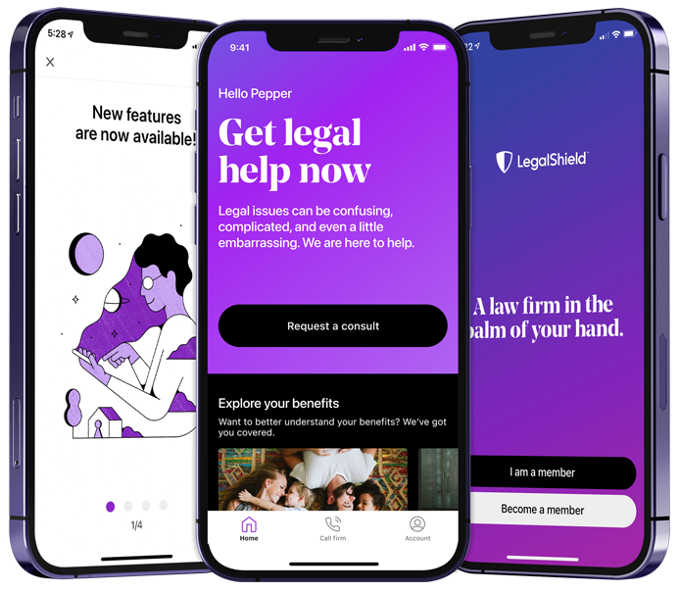
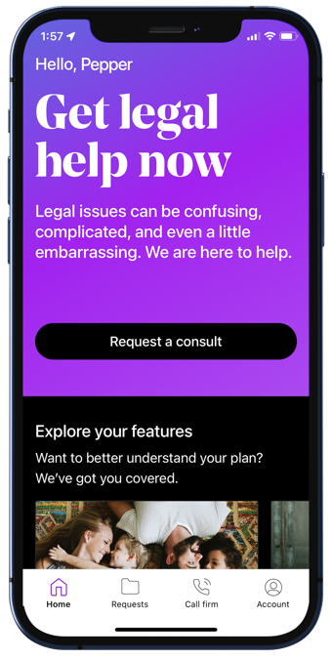
The LegalShield Mobile App
Join our collective buying power of millions and pay by the month, not by the hour!
This is a general overview of the legal plan coverage available from LegalShield for illustration purposes only. Plans and services vary from state to state and province to province. See a plan contract for specific state or province of residence for complete terms, coverage, amounts, conditions and limitations.
The LegalShield apps are available for download at no cost. Some services require an active LegalShield membership to be accessed.
Apple and the Apple logo are trademarks of Apple Inc., registered in the U.S. and other countries. App Store is a service mark of Apple Inc., registered in the U.S. and other countries.

Slide 10
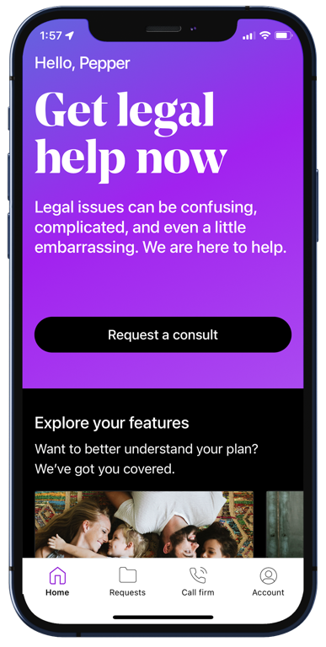
Preventative
Personal Legal Advice – Unlimited number of personal issues
Contracts/Documents Reviewed – up to 15 pages
Letters/Calls made on your behalf
Life Events
Will/Living Will/Healthcare POA/Financial POA
Traffic Ticket Assistance – moving violations
Civil Trial Defense – for covered situations (Pre-Trial/Trial)
Tax Audit Assistance
25% Preferred Member Discount
24/7 Emergency Protection
*Business Plans Also Available
Family/Domestic Services
(Available 90 consecutive days from the effective date)
Uncontested: Divorce, Adoption, Separation, Name Change

Slide 11
Preventative
Personal Legal Advice – Unlimited number of personal issues
Contracts/Documents Reviewed – up to 15 pages
Letters/Calls made on your behalf
$29.95 a month
Life Events
Will/Living Will/Healthcare POA/Financial POA
Traffic Ticket Assistance – moving violations
Civil Trial Defense – for covered situations (Pre-Trial/Trial)
Tax Audit Assistance
25% Preferred Member Discount
24/7 Emergency Protection
(About $1 a day)
*Business Plans Also Available
Family/Domestic Services
(Available 90 consecutive days from the effective date)
Uncontested: Divorce, Adoption, Separation, Name Change

Slide 12
Who is covered?
The member
The member’s spouse or domestic partner
Never married dependent children under the age of 26 living at home or full–time student
Dependent children under the age of 18 for whom the member is the legal guardian
Physically or mentally disabled children living at home

Slide 14
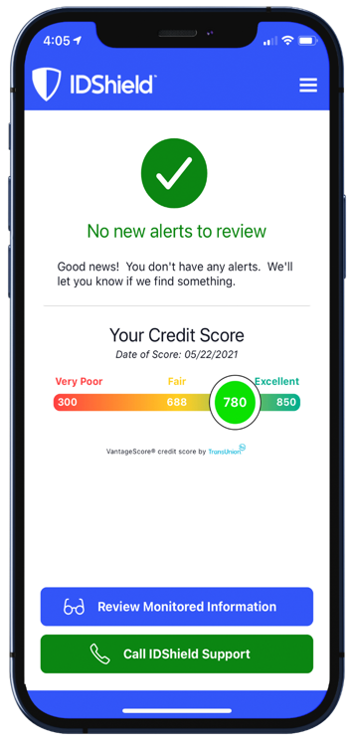
Monitoring & Alerts (Monitor everything that matters)
Credit Score
1B or 3B Credit Bureau Monitoring**
SSN
Passport
Driver’s License
Email*, Phone, DOB
Medical ID*
Username/Password*
Dark Web
Social Media
**1B or 3B Credit Bureau Monitoring depending on the plan. *Up to 10
Privacy & Social Media Reputation Management
IDShield’s proprietary technology scans for potential reputation damaging content on social media accounts such as:
Facebook
LinkedIn
Twitter
Instagram
And more!

Slide 15
Comprehensive Restoration
$1 Million Protection Policy!
Licensed Private Investigators will:
Do whatever it takes.
Work as long as it takes.
Restore identity to its pre-theft status.
IDShield for Business is available.

Slide 16
Trend Micro Maximum Security
The cloud-based AI technology offered by Trend Micro delivers highly effective and proactive protection against ever-evolving malware infections.
VPN Proxy One
Convenient protection anywhere you connect, including hotels, cafes, offices, and schools through encrypted communications provided by Trend Micro’s VPN Proxy One. Filters help block malicious websites, online fraud, and internet scams. Full
anonymity - no location or online activity tracking. Safeguards provided when you connect to a risky Wi-Fi network.
Password Manager
Get multiple device protection and privacy for your digital life.
Helps block dangerous websites
Manages and encrypts passwords
Saves time
Identify and change weak passwords
Gives you control
Creates unique, tough to hack passwords

Slide 17
Individual Plan | Family Plan
$19.95 per month | $34.95 per month
Who is covered?
Individual Plan
The member
Family Plan
The member
The member’s spouse or domestic partner and up to 10 dependent children under the age of 18
It also provides consultation and restoration services for dependent children ages 18 to 26

Slide 18
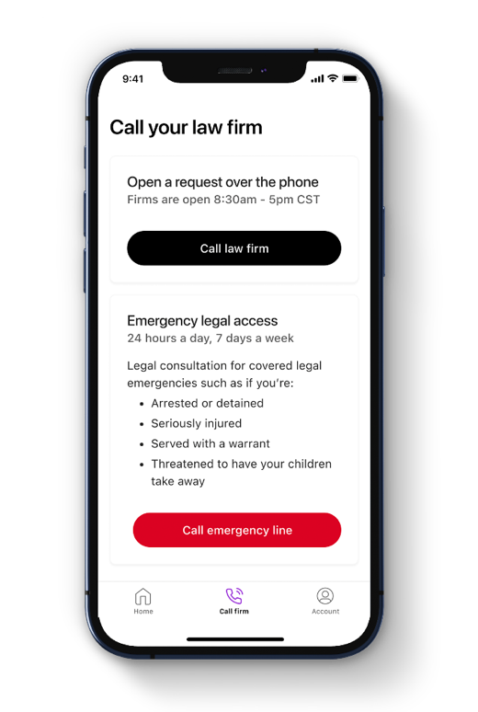
Credit Counseling & Education
Dual LegalShield and IDShield members receive the additional benefit of Credit Counseling and Education
Advice on managing your finances to maintain or develop healthy credit.
Your LegalShield Law Firm will advocate for you in the complicated world of credit matters, including sending a letter to the credit bureaus on your behalf when a bona fide error is found on your credit report.
The New Dual LegalShield and IDShield plan
will give you peace of mind with full support for
all credit related matters.
Notes:
With a dual plan membership of LegalShield and IDShield, you now receive the Bonus benefit of Credit Counseling & Education. With this new benefit you will get advice on managing your finances to maintain or develop healthy credit. In addition, your LegalShield provider law firm will now advocate for you in the complicated world of credit matters, including sending a letter to the credit bureaus on your behalf when a bona fide error is found. These benefits are only available to those who purchase the LegalShield and IDShield plan together. The New Dual LegalShield and IDShield Plan will give you peace of mind with full-service support for all of your credit related matters.

Slide 20
Become an Associate
Start part-time
Work from anywhere
Willable book of business
Residual income for the lifetime of the membership
Fast Start training class
Ongoing weekly training
Alignment with a personal mentor
Registration: One-time $99
PPLSI Advantage Plus subscription:
$24.95/month – 1st month is FREE

Slide 21
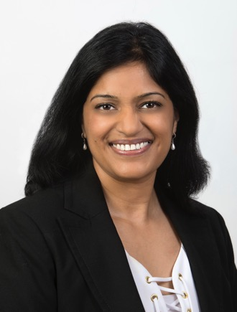
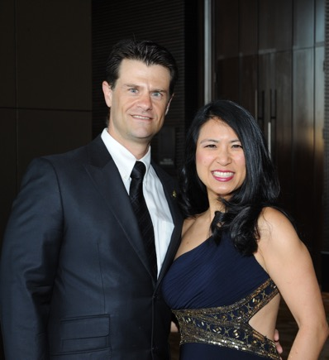
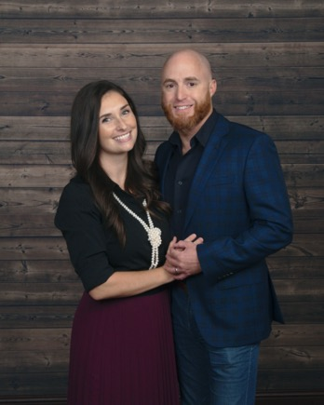
Compensation
Enroll Members Get paid $70 – $370 per subscription
Leveraged Income Build a team and earn income on memberships they enroll.
Residual Income Get paid every month for the lifetime of the membership.
Get to a Fast Start Training Earn Commissions and Fast Start Bonuses up to $300 in your first 45 days.
Brian & Melissa Carruthers
REAL ESTATE
Darnell & Traci Self
RETAIL
Alex & Julia Shahid
STUDENTS
Compensation based on $64.90 subscription. The business opportunity information is for use by LegalShield (”PPLSI”), its affiliates and its independent associates. No guarantee or promise of increased income or business is implied. Individual results and success as an independent sales associate depends on individual effort and abilities. For statistics on actual earnings, please review the Income Disclosure Statement available at opportunity.legalshield.com.
Daniel & Rebecca Gonzalez
HEALTHCARE
Anita Sarda
BUSINESS
Liz & David Lequeux
SALES

Slide 22
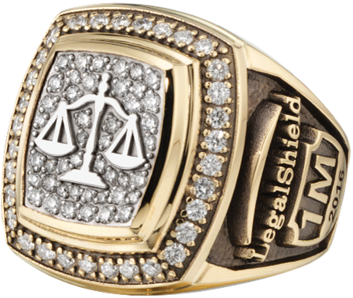
Our Proven Track Record
300+ Millionaire Club Members
700+ Ring Earners
400+ Six Figure Earners
$1 Billion Paid in Commissions in the last 10 Years
Brian & Melissa Carruthers
REAL ESTATE
Darnell & Traci Self
RETAIL
Alex & Julia Shahid
STUDENTS
Thousands of Lives Changed!
PPLSI makes no guarantee or promise of income or business as results are determined by the efforts of those individuals who market LegalShield plans as Independent Associates. These experiences are specific to each Independent Associate’s efforts, abilities and motivation. For statistics on actual earnings, please review the income disclosure statement available at www.legalshield.com/become-associate.
Daniel & Rebecca Gonzalez
HEALTHCARE
Anita Sarda
BUSINESS
Liz & David Lequeux
SALES

Slide 23
Commissions (Based on $64.90 Premium Plan)
Your Level
Personal Income
Team Override
Executive Director*
$370
$75 +
Senior Director*
$295
$75 +
Director
$220
$60 +
$300
Bonus
Senior Manager
$160
$40 +
$200 (45 Days)
Manager
$120
$30 +
$100 (20 Days)
Senior Associate
$90
$20
Associate
$70
*Based on Elite Level Commissions
The business opportunity information is for use by LegalShield, its affiliates and its independent associates. No guarantee or promise of increased income or business is implied. Individual results and success as an independent sales associate depends on individual effort and abilities. For statistics on actual earnings, please review the Income Disclosure Statement available at opportunity.legalshield.com.

Slide 24
Compensation Example
Protect 4 families a month with $64.90 memberships Earn $300–$2,292 a month What would you use this for?
Teach 25 teammates to do the same Earn $120,000 per year (25 teammates x 4 sales = 100 sales x 12 months = $1,200 sales @ $100 average override)
Compensation based on $64.90 subscription. Range examples include Performance Club Qualifying. Average override assumed to be $100 from Manager to Director.

Slide 25
Performance Club Incentive Trips & Bonuses!
Protect 2–4 Families a Month.
Earn monthly bonuses up to $500 a month.
Qualify for vacations around the globe!

Slide 26
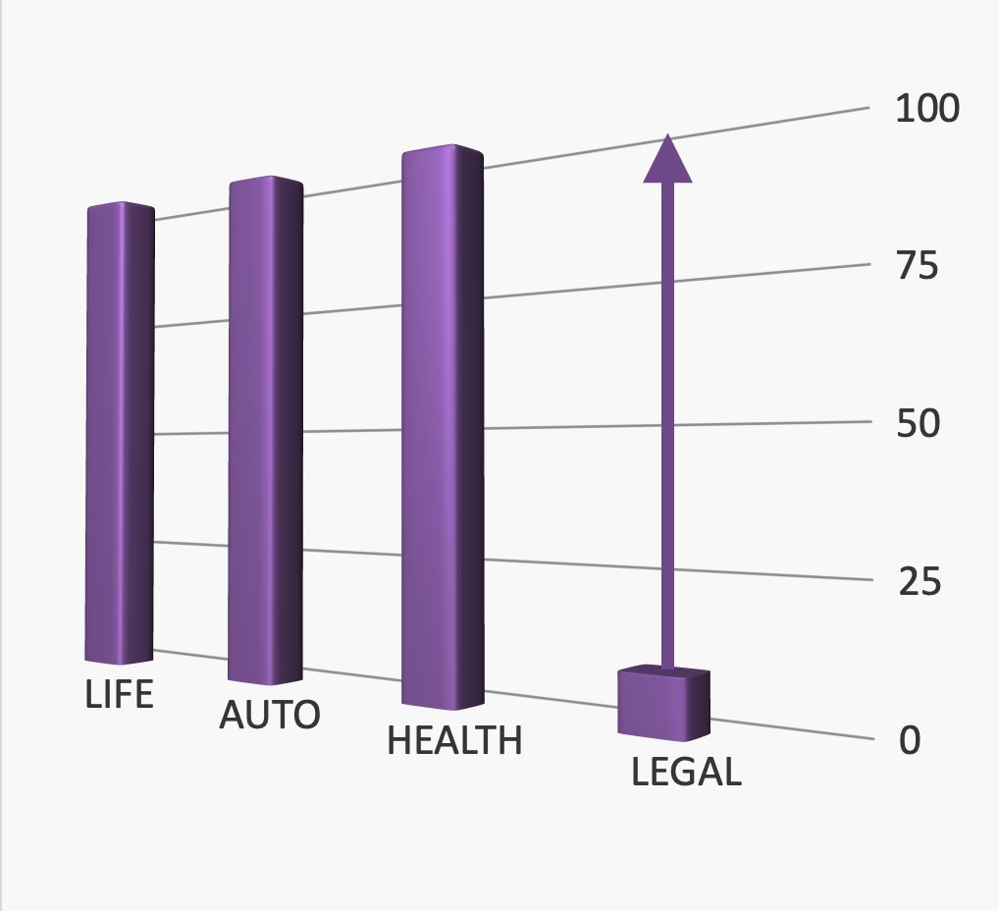
Timing is Everything
The three major divisions of the insurance industry have already achieved billions in market share.
Legal is next.

Slide 27
Timing is Everything
In a national survey, 60% reported they would be interested in buying a legal protection service if they knew it existed.
With less than 3% market penetration, the opportunity couldn’t be any brighter.

Slide 28
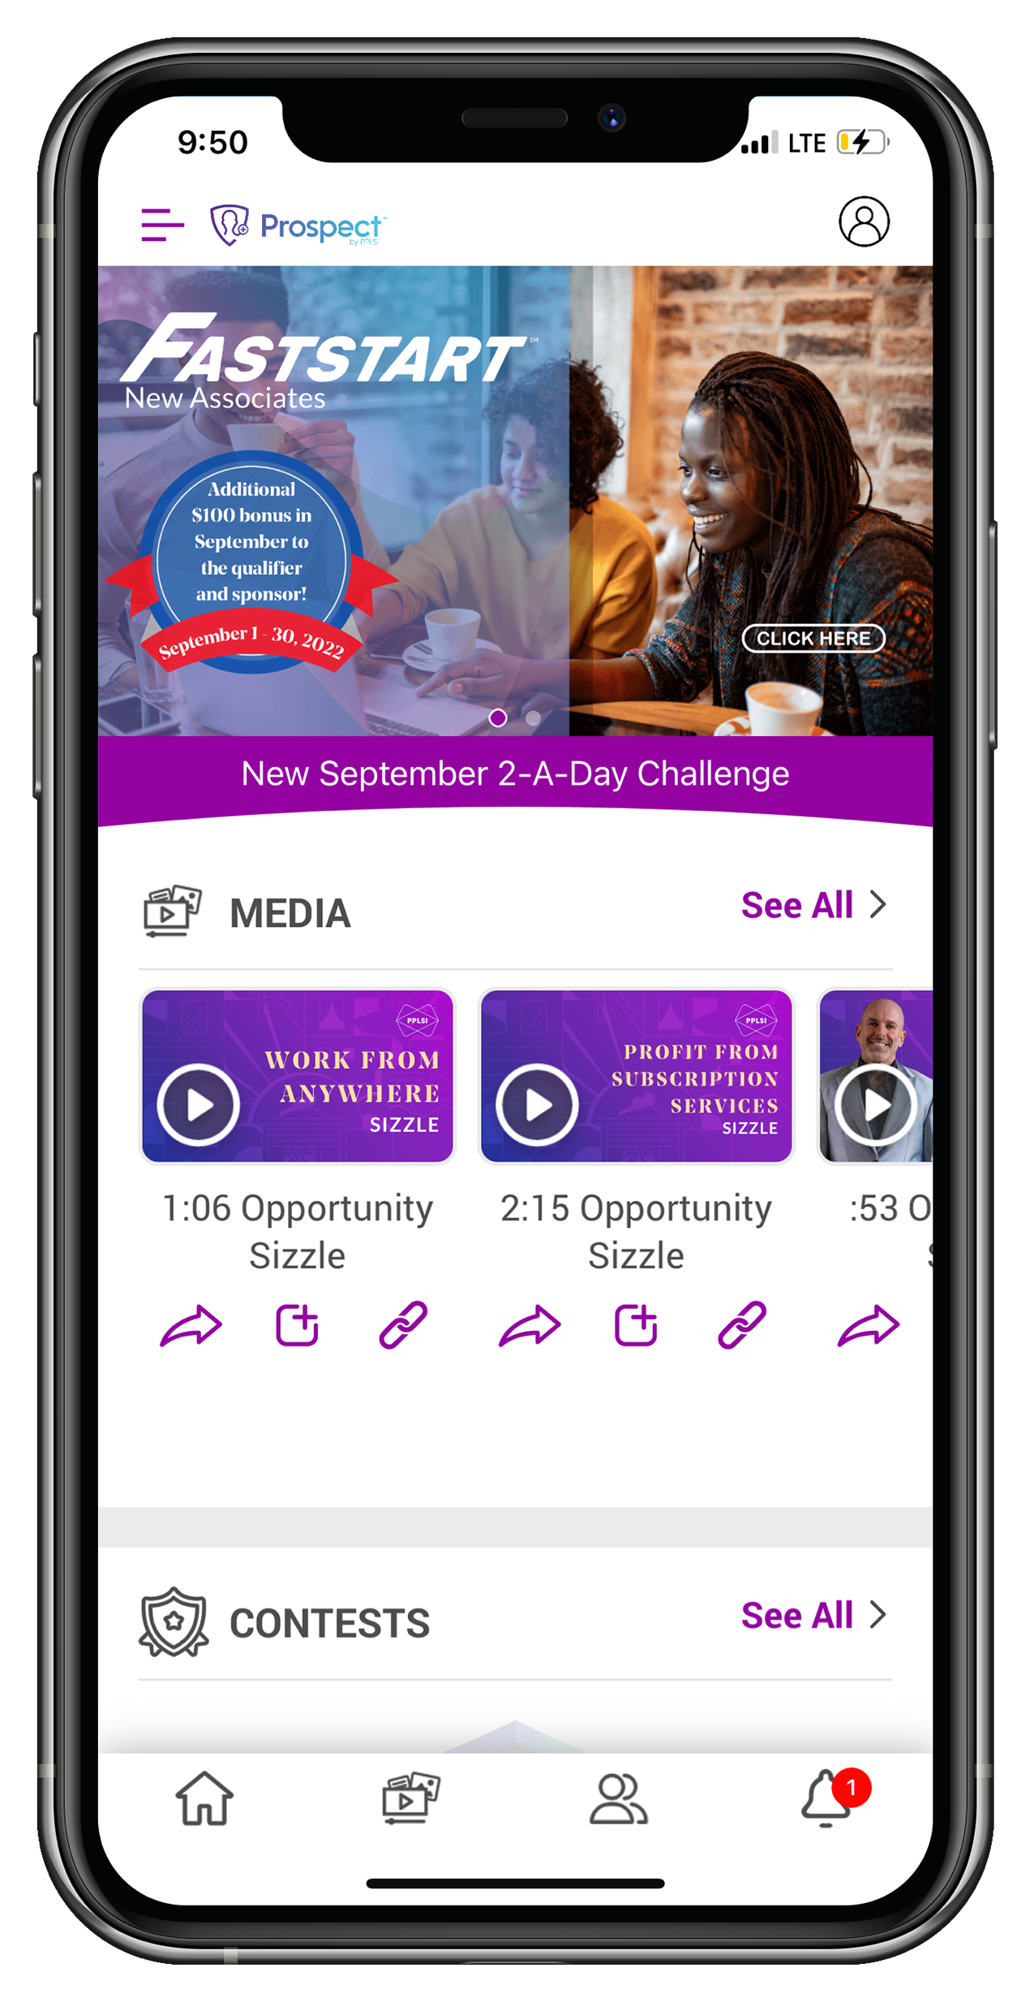
It only takes 3 minutes to get enrolled!
We will provide you with info to share with people to start signing up, and getting paid daily. Let’s go!

Slide 29
Network
2023 Performance Club Trip
July 2022 - March 2023
How to Qualify:
Group 1: Qualify for the Platinum World Council April 2022 - March 2023
Group 2: Qualify for the Circle of Champions April 2022 - March 2023
Group 3: Qualify for PC Pro July 2022 - March 2023 (6 of 8 Months)
PC qualify the other two months.
Have a minimum of 15 personal recruits with 3 Fast Start qualifiers.
Have personal and organizational retention of 65% or higher on April 1, 2023.

Slide 30
IDShield is a product of Pre-Paid Legal Services, Inc. d/b/a LegalShield ("LegalShield"). LegalShield provides access to identity theft protection and restoration services. IDShield plans are available at individual or family rates. A family plan covers the named member, named member's spouse or domestic partner and up to 10 dependent children under the age of 18. Certain benefits are only available with a 3Bureau identity theft plan and are not offered with a 1Bureau identity theft plan. For complete terms, coverage, and conditions, please see an identity theft plan. All Licensed Private Investigators are licensed in the state of Oklahoma. An Identity Fraud Protection Plan ("Plan") is issued through a nationally recognized carrier. LegalShield/IdShield is not an insurance carrier. This covers certain identity fraud expenses and legal costs as a result of a covered identity fraud event, with the amount of coverage dependent on the type of identity theft plan. See a Plan for complete terms, coverage, conditions, and limitations, and family members who are eligible under the Plan.
This is a general overview of the legal plan coverage available from Pre-Paid Legal Services, Inc. d/b/a LegalShield (“LegalShield”) for illustration purposes only. Trial defense is not available in all states. See a legal plan contract for specific state of residence for complete terms, coverage, amounts and conditions. The business opportunity information is for use by LegalShield, its affiliates and its independent associates. No guarantee or promise of increased income or business is implied. Individual results and success as an independent sales associate depends on individual effort and abilities. For statistics on actual earnings, please review the income disclosure statement available at www.wearelegalshield.com/income-disclosure. IDShield is a product of LegalShield. LegalShield provides access to identity theft protection and restoration services. IDShield plans are available at individual or family rates. A family plan covers the named member, named member’s spouse or domestic partner and up to 10 dependent children under the age of 18. Certain benefits are only available with a 3Bureau Plan. For complete terms, coverage, and conditions, please see an identity theft plan. All Licensed Private Investigators are licensed in the state of Oklahoma. An Identity Fraud Protection Plan (“Plan”) is issued through a nationally recognized carrier. LegalShield/IDShield is not an insurance carrier. This covers certain identity fraud expenses and legal costs as a result of a covered identity fraud event. See a Plan for complete terms, coverage, conditions, limitations, and family members who are eligible under the Plan.​

