Slide 1
Your Opportunity.
Your Freedom.

Slide 2
The World has Forever Changed
We are in a “work from anywhere” revolution
Income Opportunity
More Time to Build Your Business
More Flexibility
Independence
In these uncertain times, doesn’t it make sense to have a backup plan?

Slide 3
Are you working for the right kind of income?
3 forms of income
Linear income – trading time for money
Leveraged income – work with team, income potential
Residual income – can be part of your retirement plan

Slide 4
5 Areas to Evaluate
The company
The need in the marketplace
The product
The compensation
The timing

Slide 5
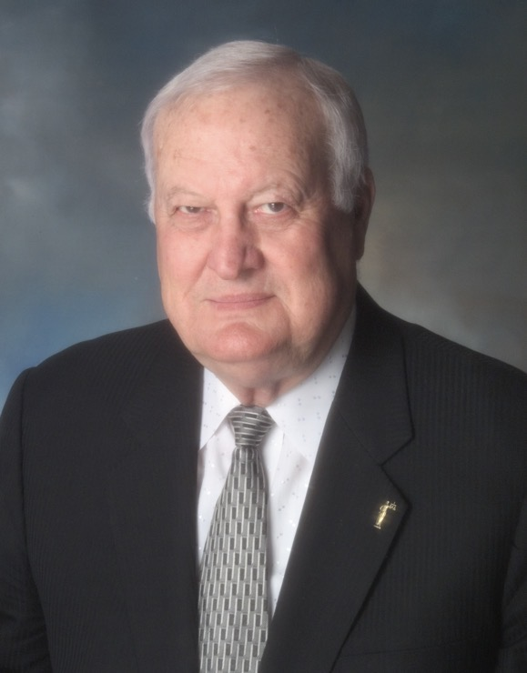
From an
Accident,
a Mission
Was Born.
Equal Access to Justice.

Slide 6
Established in 1972
Protecting & Empowering approximately 4.4 million lives in the U.S. & 5 Canadian provinces.
Our Vision
To provide EQUAL ACCESS to LIBERTY, EQUALITY, OPPORTUNITY & JUSTICE that every human deserves.

Slide 7
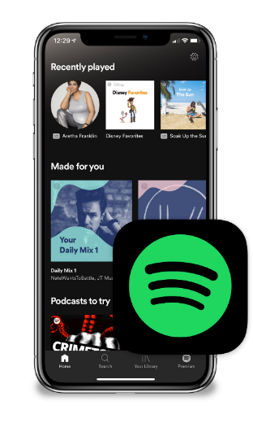
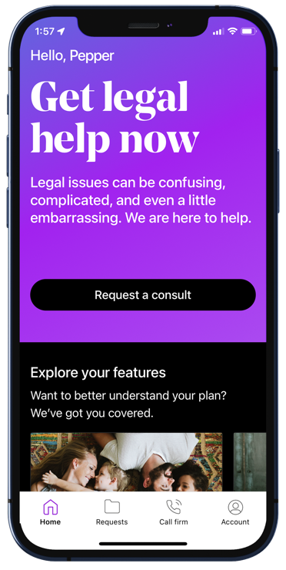
Disruptive Innovation. Simpler. Easier. More Affordable.
WHAT ABOUT GETTING
ACCESS TO THE
JUSTICE SYSTEM?
REMEMBER
SHOPPING AT THE MALL?
OR
BUYING
CDs?

Slide 8
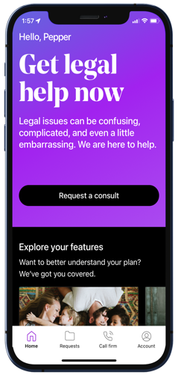
Have You Ever…
Thought about writing or revising your Will?
Been notified that your personal information was compromised?
Been treated unfairly or said, “Let me speak to your supervisor”?
Been a victim of a breach or identity theft?
Signed a contract you didn’t understand or regretted later?
Received a traffic ticket?
Had an insurance claim denied that you thought was covered?
Had questions regarding your credit score?
Bought a defective product and wondered what your rights were?
Had your social media account hacked?
Join our collective buying power of millions and pay by the month, not by the hour!

Slide 10
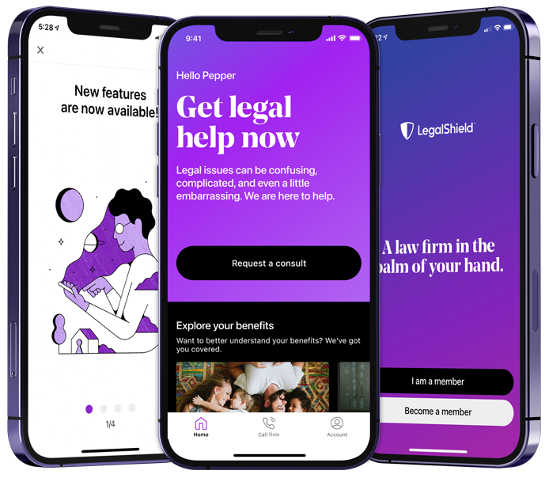
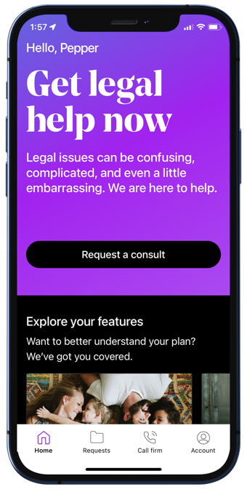
The LegalShield Mobile App
This is a general overview of the legal plan coverage available from Pre-Paid Legal Services, Inc. (“PPLSI”) for illustration purposes only. See a plan contract for specific state, province or territory of residence for complete terms, coverage, amounts and conditions. The LegalShield apps are available for download at no cost. Some services require an active LegalShield membership to be accessed.

Slide 11
Preventative
Personal Legal Advice – Unlimited number of personal issues
Contracts/Documents Reviewed – up to 15 pages each
Letters/Calls made on your behalf
Life Events
Will/Living Will/Healthcare POA/Financial POA
Traffic Ticket Assistance – moving violations
Civil Trial Defense – for covered situations (Pre-Trial/Trial)
Tax Audit Assistance
25% Preferred Member Discount
24/7 Emergency Protection
Family/Domestic Services
(Available 90 consecutive days from the effective date)
Uncontested: Divorce, Adoption, Separation, Name Change
This is a general overview of the legal plan coverage available from Pre-Paid Legal Services, Inc. (“PPLSI”) for illustration purposes only. See a plan contract for specific state, province or territory of residence for complete terms, coverage, amounts and conditions. The LegalShield apps are available for download at no cost. Some services require an active LegalShield membership to be accessed.

Slide 12
Preventative
Personal Legal Advice – Unlimited number of personal issues
Contracts/Documents Reviewed – up to 15 pages each
Letters/Calls made on your behalf
$29.95 a month
Life Events
Will/Living Will/Healthcare POA/Financial POA
Traffic Ticket Assistance – moving violations
Civil Trial Defense – for covered situations (Pre-Trial/Trial)
Tax Audit Assistance
25% Preferred Member Discount
24/7 Emergency Protection
(About $1 a day)
*Business Plans Also Available
Family/Domestic Services
(Available 90 consecutive days from the effective date)
Uncontested: Divorce, Adoption, Separation, Name Change

Slide 13
Who is covered?
The member
The member’s spouse or domestic partner
Never married dependent children under the age of 26 living at home or full–time student
Dependent children under the age of 18 for whom the member is the legal guardian
Physically or mentally disabled children living at home

Slide 15
Monitoring & Alerts (Monitor everything that matters)
Credit Score
1B or 3B Credit Bureau Monitoring*
SSN
Passport
Driver’s License
Email, Phone, DOB
Medical ID
Username/Password
Dark Web
Social Media
*1B or 3B Credit Bureau Monitoring depending on the plan.
Privacy & Social Media Reputation Management
IDShield’s proprietary technology scans for potential reputation damaging content on social media accounts such as:
Facebook
LinkedIn
Twitter
Instagram
And more!
All these great features can be accessed from a single log-in – anywhere you are!
IDShield is a product of Pre-Paid Legal Services, Inc. (“PPLSI”) and provides access to identity theft protection and restoration services. IDShield plans are available at individual or family rates. A family plan covers the named member, named member’s spouse or domestic partner and eligible dependent children under the age of 18. Consultation and restoration services are available for eligible dependent children ages 18 to 26 who permanently reside in the same residence as the named member. All Licensed Private Investigators are licensed in the state of Oklahoma. An Identity Fraud Protection Plan (“Plan”) is issued through a nationally recognized carrier. IDShield/PPLSI is not an insurance carrier. This covers certain fraud expenses and legal costs as a result of a covered identity fraud event. See a Plan for complete terms, coverage, conditions, limitations, and family members who are eligible under the Plan.

Slide 16
Comprehensive Restoration
$3 Million Protection Plan for identity theft-related losses!
Licensed Private Investigators will:
Do whatever it takes.
Work as long as it takes.
Restore identity to its pre-theft status.

Slide 17
Trend Micro Maximum Security
The cloud-based AI technology offered by Trend Micro delivers highly effective and proactive protection against ever-evolving malware infections.
VPN Proxy One
Convenient protection anywhere you connect, including hotels, cafes, offices, and schools through encrypted communications provided by Trend Micro’s VPN Proxy One. Filters help block malicious websites, online fraud, and internet scams. Full anonymity - no location or online activity tracking. Safeguards provided when you connect to a risky Wi-Fi network.
Password Manager
Get multiple device protection and privacy for your digital life.
Helps block dangerous websites
Manages and encrypts passwords
Saves time
Identifies and changes weak passwords
Gives you control
Creates unique, tough-to-hack passwords

Slide 18
Credit Counseling and Education
Our identity theft specialists will provide one-on-one education and provide information to help you understand your valuable credit rating and actions that are likely to have an impact on your credit score when you have both a legal and identity plan with LegalShield.
Privacy Management
Rather than leaving security up to chance, you can proactively arm yourself against cybercrimes and reputation hijacking. Our identity theft specialists can consult you on best practices to ensure that your private information remains private.
Individual Plan | Family Plan
$19.95 per month | $34.95 per month
Trend Micro’s VPN Proxy One
covers up to 3 devices
Trend Micro’s VPN Proxy One
covers up to 15 devices

Slide 19
Who is covered?
Individual Plan
The member
Family Plan
The member
The member’s spouse or domestic partner and dependent children under the age of 18
Dependent children ages 18 to 26 – consultation and restoration services

Slide 20
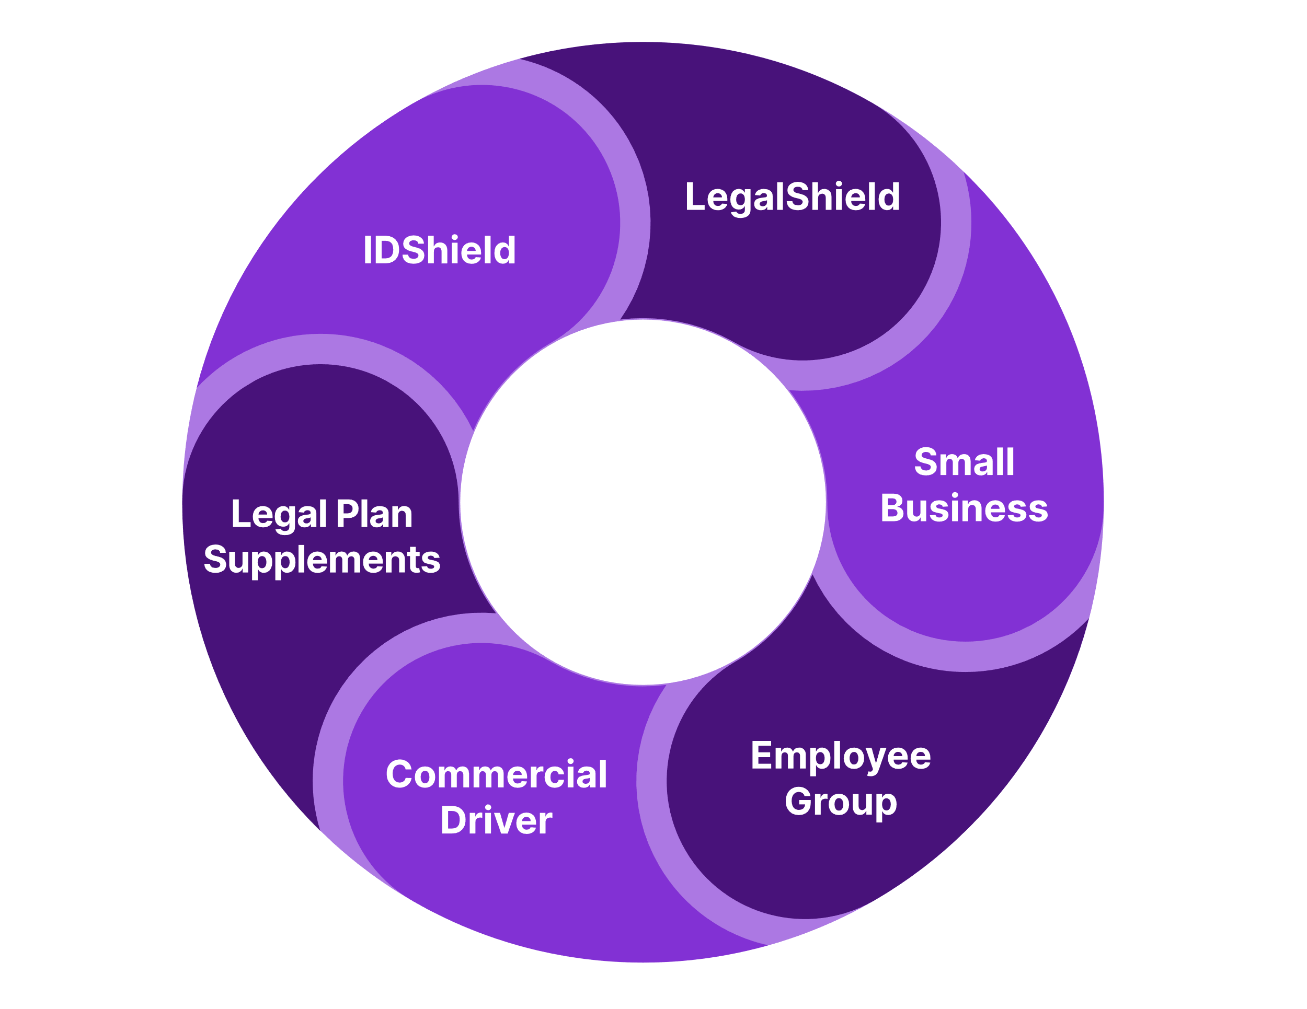
The Wheel of Opportunity
Providing powerful benefits uniquely designed for you!

Slide 22
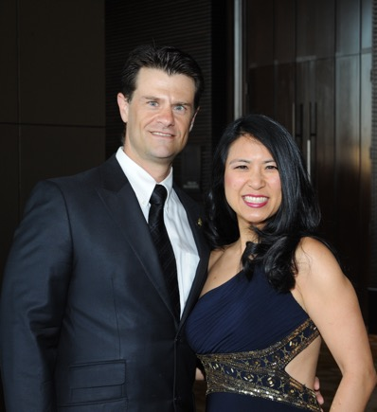
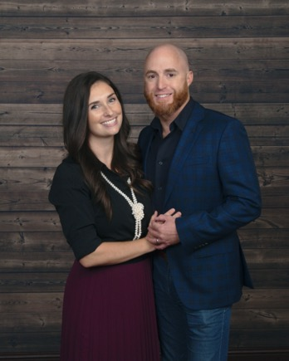
Compensation
Enroll Members Get paid $70 – $370 per subscription. ($70 at associate level up to $370 at highest level)
Leveraged Income Build a team and earn income on memberships they enroll.
Residual Income Get paid 10% of commissions again on month 13! Get paid every month for the lifetime of the membership.
Get to a Fast Start Training Earn Commissions and Fast Start Bonuses up to $700 in your first 45 days.
Brian & Melissa Carruthers
REAL ESTATE
Darnell & Traci Self
RETAIL
Alex & Julia Shahid
STUDENTS
Compensation based on $64.90 subscription. The business opportunity information is for use by its affiliates and its independent associates. No guarantee or promise of increased income or business is implied. Individual results and success as an independent sales associate depends on individual effort and abilities. For statistics on actual earnings, please review the Income Disclosure Statement available at wearelegalshield.com/income-disclosure.
Anita Sarda
BUSINESS
Liz & David Lequeux
SALES
Daniel & Rebecca Gonzalez
HEALTHCARE

Slide 23
Compensation Example
Protect 4 families a month with $64.90 memberships Earn $300–$2,292 a month What would you use this for?
Teach 25 teammates to do the same Earn $120,000 per year (25 teammates x 4 sales = 100 sales x 12 months = $1,200 sales @ $100 average override)
Compensation based on $64.90 subscription. Range examples include Performance Club Qualifying. Average override assumed to be $100 from Manager to Director.

Slide 24
Commissions (Based on $64.90 Premium Plan)
Your Level
Personal Income
Team Override
Executive Director*
$370
$75 +
$600
Upline Bonus
Senior Director*
$295
$75 +
Director
$220
$60 +
$300
Bonus
Sponsor Bonus
Senior Manager
$160
$40 +
$500 (45 Days)
Manager
$120
$30 +
$700
FastStart
Qualifier Bonus
$200 (20 Days)
Senior Associate
$90
$20
Associate
$70
*Based on Elite Level Commissions
The business opportunity information is for use by Pre-Paid Legal Services, Inc. ("PPLSI") its affiliates and its independent associates. No guarantee or promise of increased income or business is implied. Individual results and success as an independent sales associate depends on individual effort and abilities. For statistics on actual earnings, please review the Income Disclosure Statement available at wearelegalshield.com/income-disclosure.

Slide 25
Performance Club Incentive Trips & Bonuses!
Protect 2–4 families a month.
Earn monthly bonuses up to $500 a month.
Qualify for vacations around the globe!
By participating in any Pre-Paid Legal Services Inc., (“PPLSI”) incentive or bonus program and to receive benefits, cash or otherwise, the associate agrees to have his/her full name, associate title, level, or standing published and recognized in PPLSI marketing materials, whether oral, written or electronic. PPLSI reserves the right, in its sole discretion, to review all incentives and bonuses, business submitted or activity, and where necessary, in its sole discretion, delay or stop payment of any bonus, to chargeback bonuses when appropriate, and to amend or revoke this incentive, or any part thereof, at any time. Please refer to your Associate Agreement and Policies and Procedures for details on incentives, bonuses or compensation as the Associate Agreement and Policies and Procedures for details on incentives, bonuses or compensation as the Associate Agreement and Policies and Procedures are the governing contract for all business between you and PPLSI. This incentive or bonus program is not a separate contract and no guarantee or promise of increased income or business is implied. Individual results and success as an independent sales associate depends on individual effort and abilities. For statistics on actual earnings please review the Income Disclosure Statement at wearelegalshield.com/income-disclosure.

Slide 26
5 Areas to Evaluate
The company
The need in the marketplace
The product
The compensation
The timing

Slide 27
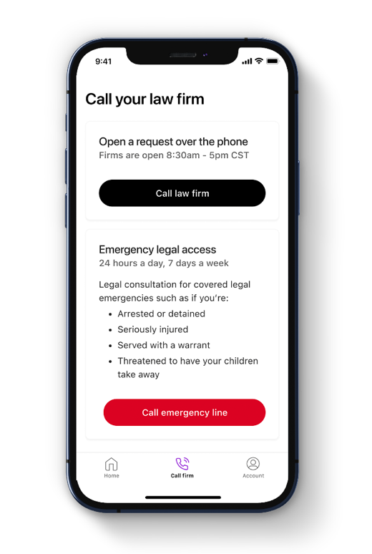
Become an Associate
Start part-time
Work from anywhere
Willable book of business
Residual income for the lifetime of the membership
Fast Start training class
Ongoing weekly training
Alignment with a personal mentor
Registration: One-time
PPLSI Advantage Plus subscription:
$24.95/month – 1st month is FREE
Right Now Only $49!

Slide 28
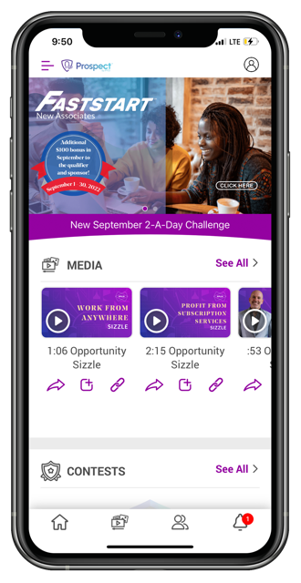
It only takes 3 minutes to get enrolled!
Getting Started is as Simple as 1, 2, 3!
1
Enroll in the Membership
2
Become an Associate
3
Gain the Opportunity to Get Paid Daily!
Compensation based on $64.90 subscription. The business opportunity information is for use by Pre-Paid Legal Services, Inc. (“PPLSI”), its affiliates and its independent associates. No guarantee or promise of increased income or business is implied. Individual results and success as an independent sales associate depends on individual effort and abilities. For statistics on actual earnings, please review the Income Disclosure Statement available at wearelegalshield.com/income-disclosure.

Slide 29
So What Do You Do?
Tomorrow at
8:00 EST • 7:00 CST
Pinnaclezoom.com
Code: 1234

Slide 30
This is a general overview of the legal plan coverage available from Pre-Paid Legal Services, Inc. (“PPLSI”) for illustration purposes only. Trial defense is not available in all states. See a legal plan contract for specific state of residence for complete terms, coverage, amounts and conditions. The business opportunity information is for use by PPLSI, its affiliates and its independent associates. No guarantee or promise of increased income or business is implied. Individual results and success as an independent sales associate depends on individual effort and abilities. For statistics on actual earnings, please review the income disclosure statement available at wearelegalshield.com/income-disclosure. IDShield is a product of PPLSI. PPLSI provides access to identity theft protection and restoration services. IDShield plans are available at individual or family rates. A family plan covers the named member, named member’s spouse or domestic partner and dependent children under the age of 18. Certain benefits are only available with a 3Bureau Plan. For complete terms, coverage, and conditions, please see an identity theft plan. All Licensed Private Investigators are licensed in the state of Oklahoma. An Identity Fraud Protection Plan (“Plan”) is issued through a nationally recognized carrier. PPLSI is not an insurance carrier. This covers certain identity fraud expenses and legal costs as a result of a covered identity fraud event. See a Plan for complete terms, coverage, conditions, limitations, and family members who are eligible under the Plan.

