Slide 1

Welcome!
Our Event Will Begin Shortly

Slide 2

What do you ultimately want?
Change where you live.
FREEDOM

Slide 3

The World has Forever Changed
We are in a “work from anywhere” revolution.
Today people are looking for:
More Income
More Time
More Flexibility
Independence
In these uncertain times, doesn’t it make sense to have a backup plan?
3

Slide 4

Are you working for the right kind of income?
3 forms of income
Linear income – trading time for money
Leveraged income – work with team, unlimited income potential
Residual income – your retirement plan

Slide 5

“Whoever solves the biggest problems for the most people makes
the most money in this world.”
- Brian Carruthers, Author of Building an Empire

Slide 6
Today We Will Discuss
  OUR COMPANY
  Solving 2 major problems in North America today
  OUR SERVICES
  Helping individuals, families and business owners
  YOUR COMPENSATION
  Earn linear, leveraged & residual income plus free trips

Slide 7


Have You Ever…
Received a Traffic Ticket?
Thought about writing or revising your Will?
Lost a job and wanted to know your rights?
Been treated unfairly or said, “Let me speak to your supervisor”?
Been a victim of a breach or Identity theft?
Signed a contract you didn’t understand or regretted later?
Had an insurance claim denied that you thought was covered?
Had questions regarding your credit score?
Bought a defective product and wondered what your rights were?
Had your social media account hacked?

Slide 8
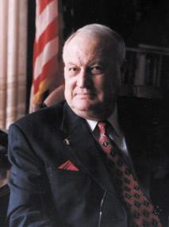






Established in 1972
PROTECTING & EMPOWERING
4.5 million lives with a dedicated network of quality law firms in the U.S. & Canada.
Our Vision
To build a BETTER WORLD where access
to JUSTICE is EQUAL for every human.

Slide 9

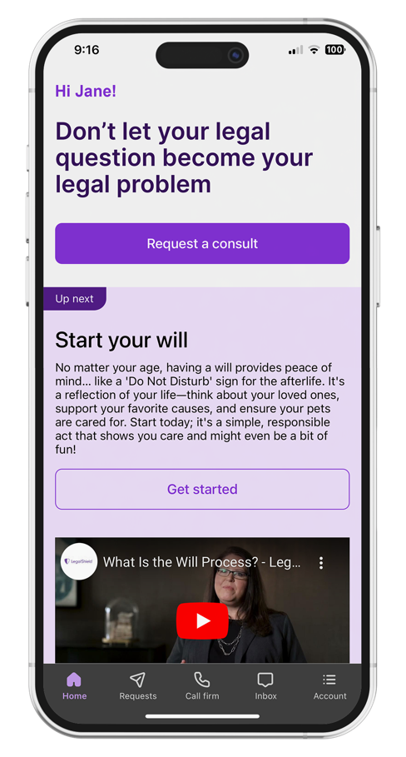
Preferred Legal Plan
Covers member, spouse, and eligible dependent children.
Consultation Unlimited number of personal legal
matters.
Letters or Phone Calls Made on your behalf.
Document Review Unlimited personal legal
documents up to 25 pages each.
Residential Loan Document Review Primary
residence.¹
Residential Tenant Lease Advice, review of
documents and negotiations with a landlord.
Preparation, Annual Reviews and Updates
Will
Durable Power of Attorney
Physician’s Directive/Living Will
Traffic Ticket Assistance Advice and consultation, plus two (2) covered violations per year, per person.²
Property Damage Assistance³
Civil Trial Defense Subject to schedule of hours for covered matters.
IRS Audit Assistance Consultation, audit representation and pre-trial negotiation.
Uncontested
        Minor Child Adoption¹
Name Change
Civil Annulment or Separation or divorce⁴
Prenuptial and Post-nuptial Preparation⁴
24/7 Emergency Access if your rights are being
denied or threatened (for covered emergencies).
Online Notarization Up to (5) per membership year.
E-Signature Unlimited.
25% Discount Off the Provider Law Firm’s standard hourly rate.
This is a general overview of the legal plan coverage available from Pre-Paid Legal Services, Inc. (“PPLSI”) for illustration purposes only. In New York and Nevada an additional fee may be required for some services. See a legal plan details for pre-trial/trial time hours that may apply. Uncontested services have a 180-day waiting period.
1 Primary member and spouse only. 2 $79 fee each time the lawyer makes a court appearance. 10 day waiting period. 3 Can receive when a driver or passenger in or struck by a motor vehicle. Claims $5,000 or less. 4 Primary member only.

Slide 10
Preferred Legal Plan
$37.95 per month - Covers member, spouse, and eligible dependent children.
Consultation Unlimited number of personal legal
matters.
Letters or Phone Calls Made on your behalf.
Document Review Unlimited personal legal
documents up to 25 pages each.
Residential Loan Document Review Primary
residence.¹
Residential Tenant Lease Advice, review of
documents and negotiations with a landlord.
Preparation, Annual Reviews and Updates
Will
Durable Power of Attorney
Physician’s Directive/Living Will
Traffic Ticket Assistance Advice and consultation, plus two (2) covered violations per year, per person.²
Property Damage Assistance³
Civil Trial Defense Subject to schedule of hours for covered matters.
IRS Audit Assistance Consultation, audit representation and pre-trial negotiation.
Uncontested
        Minor Child Adoption¹
Name Change
Civil Annulment or Separation or divorce⁴
Prenuptial and Post-nuptial Preparation⁴
24/7 Emergency Access if your rights are being
denied or threatened (for covered emergencies).
Online Notarization Up to (5) per membership year.
E-Signature Unlimited.
25% Discount Off the Provider Law Firm’s standard hourly rate.
This is a general overview of the legal plan coverage available from Pre-Paid Legal Services, Inc. (“PPLSI”) for illustration purposes only. In New York and Nevada an additional fee may be required for some services. See a legal plan details for pre-trial/trial time hours that may apply. Uncontested services have a 180-day waiting period.
1 Primary member and spouse only. 2 $79 fee each time the lawyer makes a court appearance. 10 day waiting period. 3 Can receive when a driver or passenger in or struck by a motor vehicle. Claims $5,000 or less. 4 Primary member only.

Slide 11

How do we do it?
Over 4 million lives protected!
Members Pay a Monthly Membership Fee
We pay the Provider Firms a percentage of the monthly fees collected.
It’s the collective buying power of Millions that makes our access affordable!
A Shared Economy Process
Notes:
expected and unexpected
Expected – good transportation, good customer service, to be treated fairly, to be paid by your customers, to get married if we meet the right person
Unexpected – an accident, bad customer service, to be treated unfairly, to be sued as a business owner, to get divorced

Slide 12
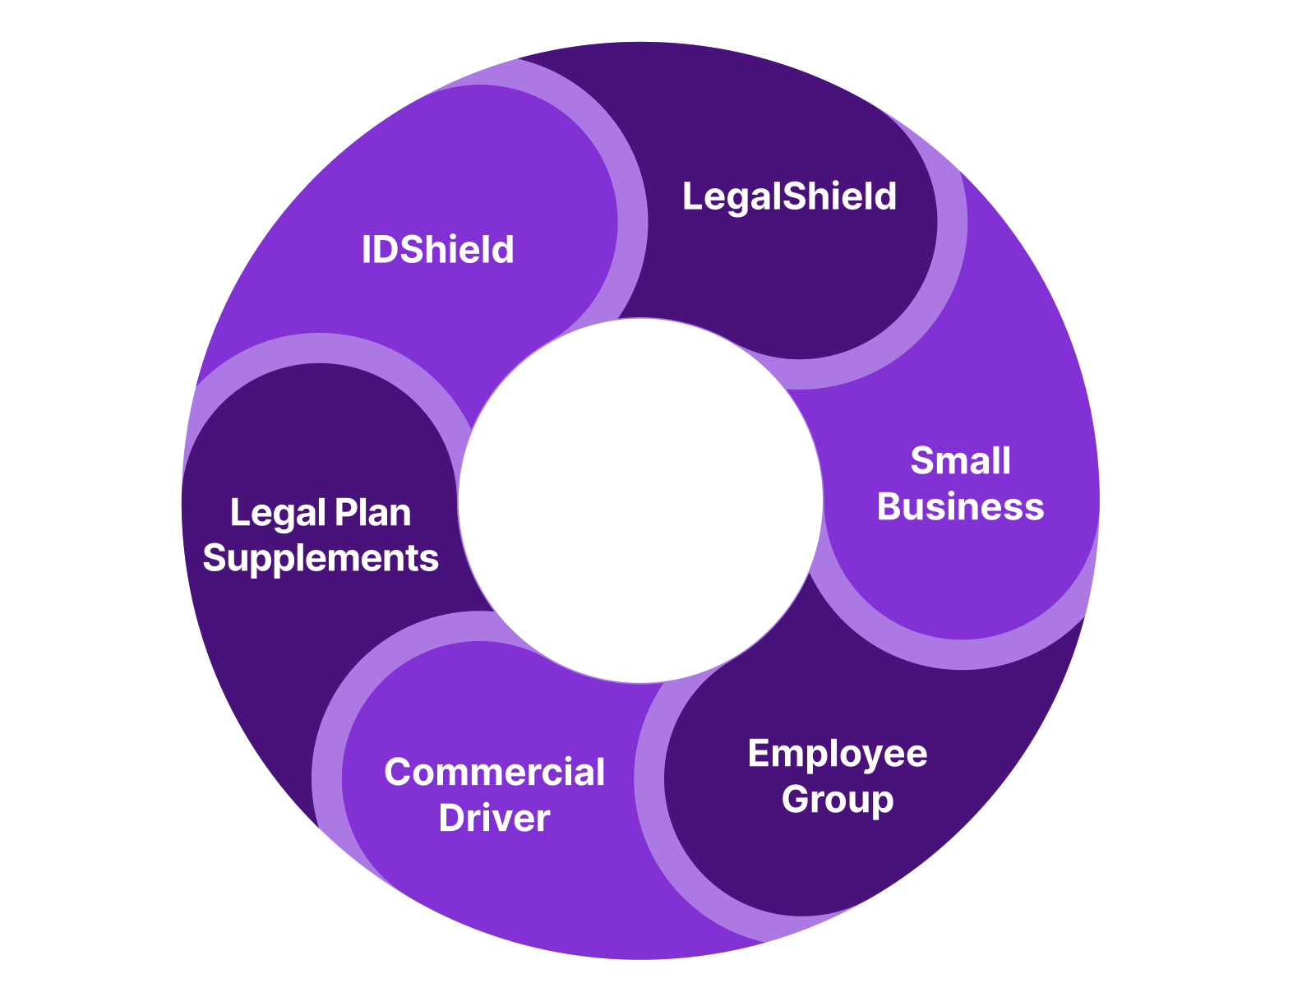

Offering a Portfolio of Services
Services uniquely designed for you, your family, your business, your employees, your community, & your clients!
Suite of Personal Legal Plans
Individual and Family Identity Theft Plans
Suite of Small Business Legal Plans
Specialty Legal Plans
  Commercial Drivers
  Public Servants (Employee Benefit Plan)
Supplemental Plans for Additional Benefits
  Home Business
  Gun Owners
  RideShare and Delivery
  Trial Defense & Trial Defense for Business
  Business Plus (Consulting)
Employee Benefit Options
Opportunity

Slide 13
Small Business Legal Plans
Business Benefits | Pro $169 | Plus $99 | Essentials $49
Authorized Users | Up to 5 | Up to 3 | Up to 2
In/Out of State Matters* | Interstate Coverage* | Interstate Coverage* | In State Only
Advice & Consultation | Included* | Included* | Included
Letters/Phone Calls | Up to 40* | Up to 20 * | Up to 10
Document Review | Up to 40 with 25 pages* | Up to 20 with 20 pages* | Up to 10 with 15 pages
Designated Consultation | 5, 30-minute consultations | 5, 30-minute consultations | 3, 30-min consultations
Collection Letters | Up to 15* | Up to 10* | Up to 5
IRS Audit Services | 50 hours | 25 hours | 25% Discount
Employee Handbook Drafting | $500 flat fee, 1 per year | $750 flat fee, 1 per year | 25% Discount
Custom Contract Drafting | $250 each, up to 25 pages | $250 each, up to 25 pages | 25% Discount
Trademark Or Copyright | Legal work of 1 per year | Legal work of 1 per year | 25% Discount
Other Business Legal Work | 25% Discount | 25% Discount | 25% Discount
Trial Defense Supplement add-on | 100 hours - $14.95 | 100 hours - $14.95 | Not applicable
Average hourly rate of a business attorney _______? | $183.95 per month $1.06 per hour, 40 business hours per week | $113.95 per month $.68 per hour, 40 business hours per week | $49 per month $.28 per hour, 40 bus. hours per week

Slide 14
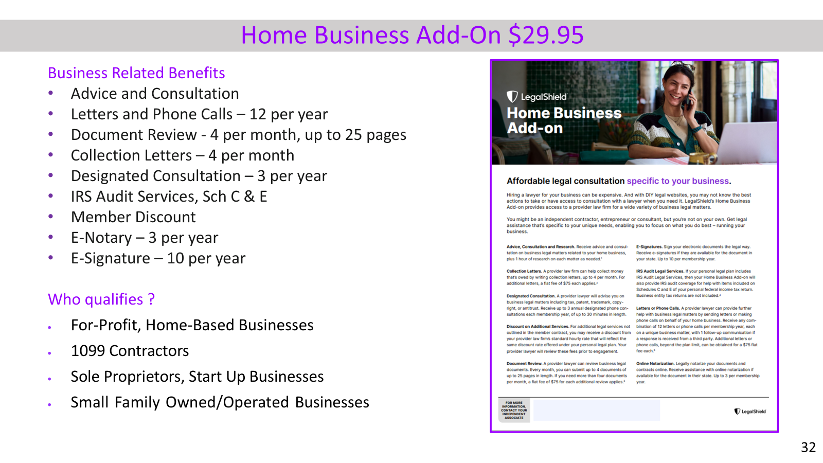

Slide 15
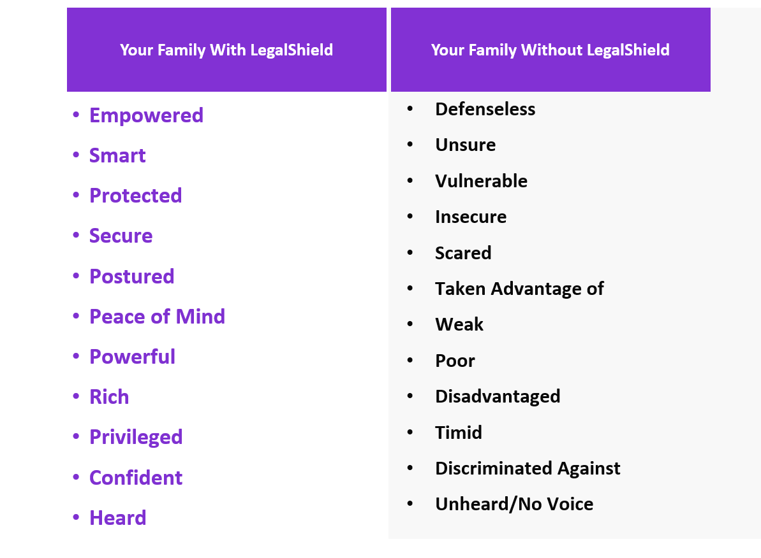
We Asked Our Members How Having LegalShield Makes Them Feel

Slide 16
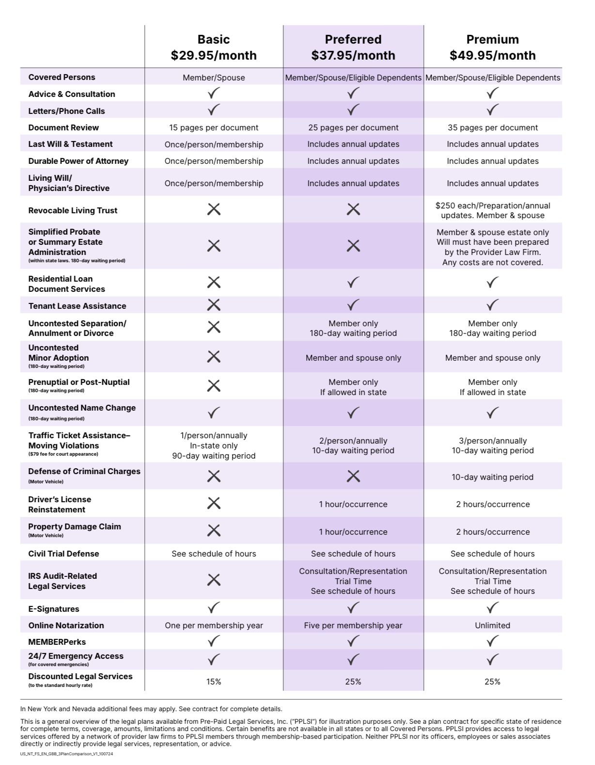
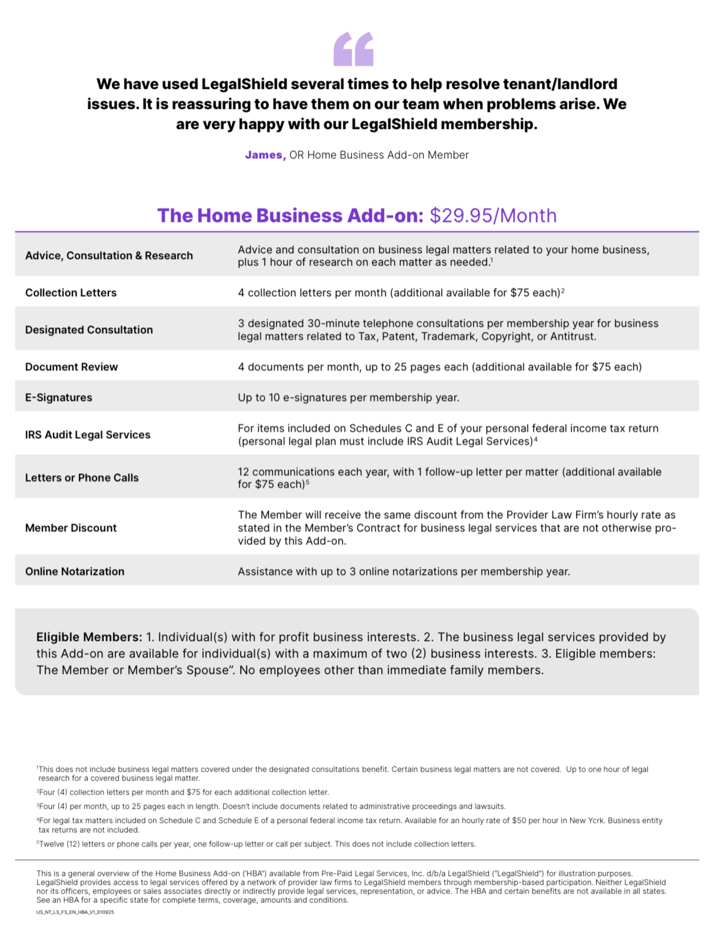

Slide 17
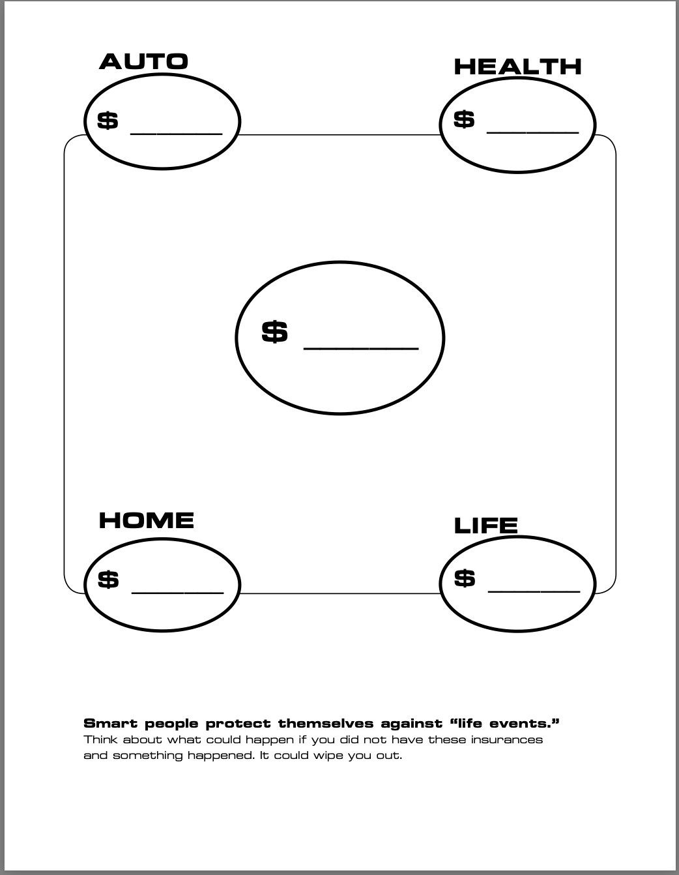
Protection Review

Slide 18


Slide 19

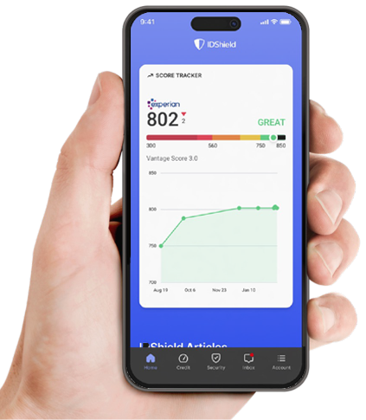
Common types of Identity Theft:
Tax returns
Medical claims
Social Security claims
Credit
Driver’s License
Criminal/Character
You are guilty until proven innocent!
Exclusions and limitations apply. Services and benefits vary by state/province. Please review a contract for complete terms, conditions and exclusions before purchase. IDShield is a product of LegalShield and provides access to identity theft protection and restoration services.

Slide 20

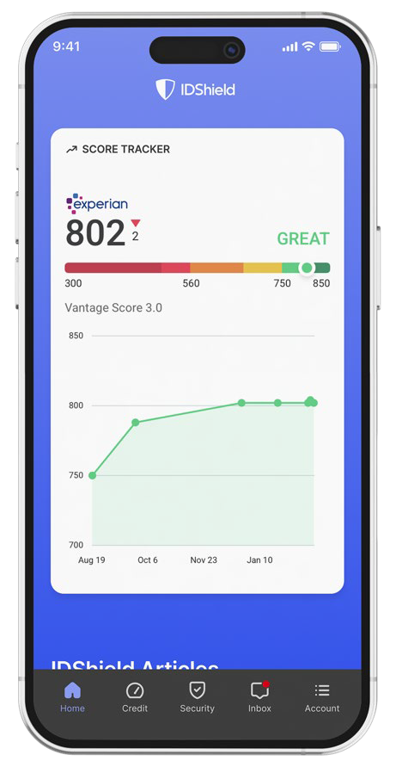

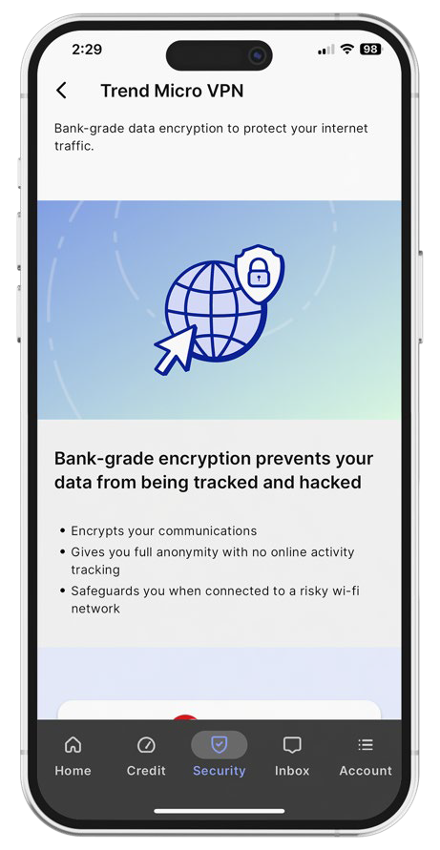
IDShield Plan
Family Plan $34.95 per month with 3 bureau monitoring
Individual Plan $19.95 per month with 3 bureau monitoring
Employee Group Rates available
Credit Score Tracker
Track your Experian credit score each month
Privacy Check
Help keep your information away from data brokers.
Trend Micro Maximum Security
VPN - Turns a public hotspot into a secure Wi-Fi connection.*
Password Manager - Multiple device protection for your digital life.**
Cybersecurity and device protection: We help protect your devices from viruses, malware, and ransomware.*
Reputation Management
Our technology scans certain social media
accounts and Google searches every week
for harmful content.
We can monitor Facebook, Instagram,
LinkedIn YouTube and X (formerly known
as Twitter).
Monitoring & Alerts
Credit Score
SSN, Passport, Driver’s License
Address, Email, Phone, DOB
Court & Public Records
Dark Web & Internet
Social Media
And More!
Financial Threshold Account Monitoring
Receive an alert on financial withdraws, balance transfers & large purchases
Identity Consultation
Identity theft specialists available 24/7 for covered emergencies.
Full-Service Restoration
By licensed private investigators.
$3M Fraud Protection
Up to $3M for covered identity theft-related losses.
Credit Cards
Checking/Savings Account
Retirement Plans
Loans
And More!
Family Plan Covers member and spouse and up to 10 dependent children under the age of 18. Provides consultation and restoration for eligible dependents up to age 26. Individual Plan Covers the member.
*All Licensed Private Investigators are licensed in the state of Oklahoma
*Individual plan covers up to three (3) devices. Family plan covers up to fifteen (15) devices. **Individual plan covers up to one (1) device. Family plan covers up to six (6) devices.

Slide 21


Slide 22

Is this an idea worth sharing?
Help us spread the word

Slide 23
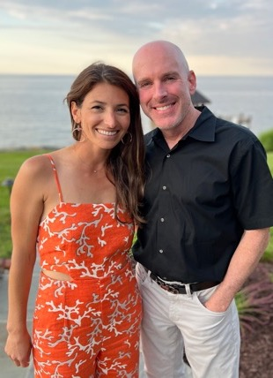



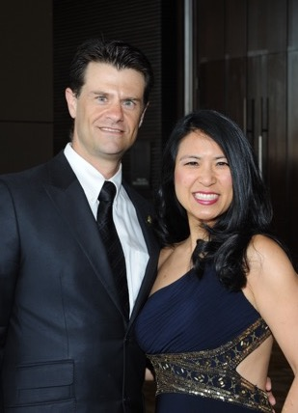

Compensation
Enroll Members
Get paid $80 – $416 per new member.
($80 at associate level up to $416 at Executive Director level)
Leveraged Income
Build a team and earn income on memberships they enroll.
Residual Income
Get paid 10% of commissions again on month 13! Earn commission every month for the lifetime of the membership.
Opportunity to Earn Bonuses
Earn up to $700 in your first 45 days.
Brian & Melissa Carruthers
REAL ESTATE
Darnell & Traci Self
RETAIL
Alex & Julia Shahid
STUDENTS
Anita Sarda
BUSINESS
Liz & David Lequeux
SALES
Daniel & Rebecca Gonzalez
HEALTHCARE
Individual results may vary. Pre-Paid Legal Services, Inc. ("LegalShield") makes no guarantees on income or success. Average 2023 compensation for active LegalShield Independent Sales Associates was approximately $2,647.89 before expenses. There’s a mandatory, one-time $49 registration fee to become an Independent Sales Associate. Optional LegalShield Advantage Plus service available for $24.95/month. This service can be cancelled at anytime. Securing career-level income with LegalShield is not typical and requires sustained hard work and dedication. Please see LegalShield’s Income Disclosure at https://www.pplsi.com/income-disclosure/ for more earnings and expense information.
23

Slide 24

Our Proven Track Record
300+
Millionaire Club Members
400+
Six Figure Earners
30,000+
Associates earning residual income
$1 Billion
Paid in Commissions the last 8 years
PPLSI makes no guarantee or promise of income or business as results are determined by the efforts of those individuals who market LegalShield plans as Independent Associates. These experiences are specific to each Independent Associate’s efforts, abilities and motivation. For statistics on actual earnings, please review the income disclosure statement available at www.legalshield.com/become-associate.
Team Pinnacle in Puerto Vallarta

Slide 25
Commissions (Based on $37.95 Preferred Legal + $34.95 IDShield)
Your Level
Personal Income
Team Override
Executive Director*
$416
$85 +
Senior Director*
$331
$85 +
Director
$246
$68 +
$336
Bonus
Senior Manager
$178
$46 +
$500¹ (45 Days)
Manager
$132
$32 +
$200² (20 Days)
Senior Associate
$100
$20
¹ Advance to Manager
² Fast Start Qualify
Associate
$80
*Based on Elite Level Commissions
Individual results may vary. Pre-Paid Legal Services, Inc. ("LegalShield") makes no guarantees on income or success. Average 2023 compensation for active LegalShield Independent Sales Associates was approximately $2,647.89 before expenses. There’s a mandatory, one-time $49 registration fee to become an Independent Sales Associate. Optional LegalShield Advantage Plus service available for $24.95/month. This service can be cancelled at anytime. Securing career-level income with LegalShield is not typical and requires sustained hard work and dedication. Please see LegalShield’s Income Disclosure at https://www.pplsi.com/income-disclosure/ for more earnings and expense information.
25

Slide 26
How to earn $1000 this week:
(Assoc -> Sr Assoc) Three $72.90 Legal/IDShield plans + 1 Associate = $240 + FSQ bonus of $200 = $440
(Sr Assoc –> MGR) 2 more Associates with $72.90 combos = $200 + ATM Bonus of $500 = $700
Total Income= $1140
Basically Enroll 5 Customers w/ Combo Package and 3 of them as Associates

Slide 27
Commissions (Based on 37.95 Legal & 34.95 IDT)
(Based on $169 Pro Biz Plan + 14.95 Trial Defense)
Your Level
Personal Income
Team Override
+ Residual Income
Executive Director*
$416 / $1,048
$85 / $212
Senior Director*
$331 / $836
$85 / $212
Director
$246 / $623
$68 / $170
$336 / $849
Bonus
Senior Manager
$178 / $453
$46 / $113
$500 (45 Days)
Manager
$132 / $340
$32 / $85
$200 (20 Days)
Senior Associate
$100 / $255
$20 / $56
Associate
$80 / $198
*Based on Elite Level Commissions
The business opportunity information is for use by LegalShield, its affiliates and its independent associates. No guarantee or promise of increased income or business is implied. Individual results and success as an independent sales associate depends on individual effort and abilities. For statistics on actual earnings, please review the Income Disclosure Statement available at opportunity.legalshield.com.

Slide 28
The Power of Part Time
Protect 4 families a month with $72.90 memberships
Earn $320–$2,164 a month
Teach 25 teammates to do the same
Earn $120,000 per year
(25 teammates x 4 sales = 100 sales x 12 months
= $1,200 sales @ $100 average override)

Slide 29
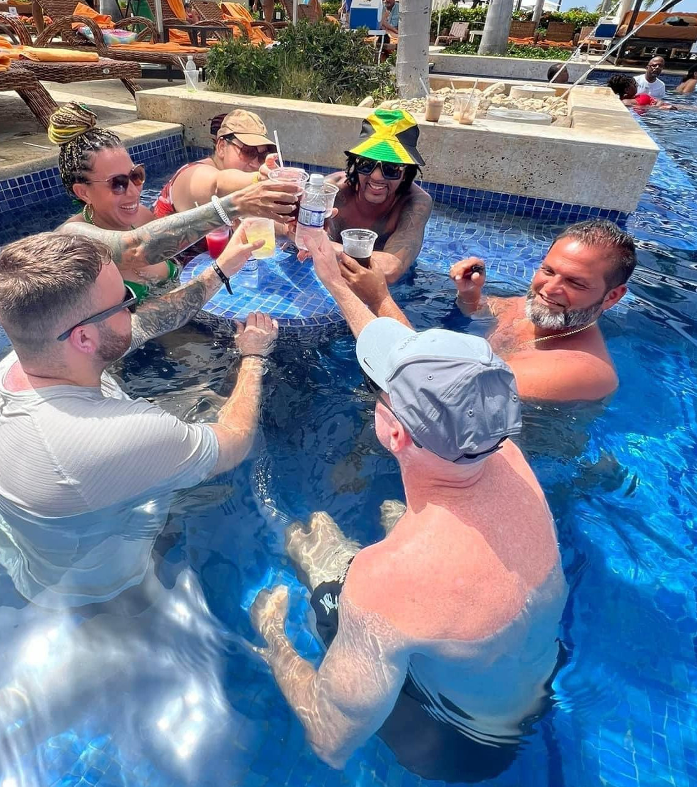
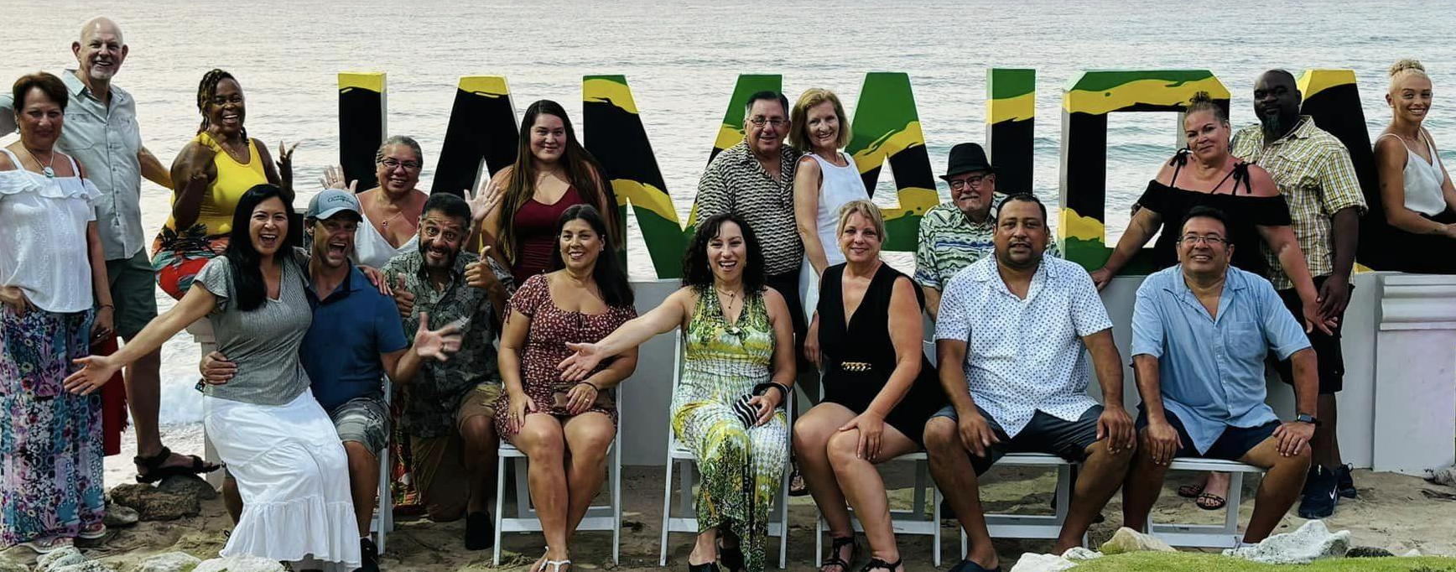

Performance Club Incentive Trips & Bonuses!
Enroll 3–4 families per month & earn bonuses of $200- $500 each month.
Qualify for all expenses paid trips!
By participating in any Pre-Paid Legal Services Inc., (“PPLSI”) incentive or bonus program and to receive benefits, cash or otherwise, the associate agrees to have his/her full name, associate title, level, or standing published and recognized in PPLSI marketing materials, whether oral, written or electronic. PPLSI reserves the right, in its sole discretion, to review all incentives and bonuses, business submitted or activity, and where necessary, in its sole discretion, delay or stop payment of any bonus, to chargeback bonuses when appropriate, and to amend or revoke this incentive, or any part thereof, at any time. Please refer to your Associate Agreement and Policies and Procedures for details on incentives, bonuses or compensation as the Associate Agreement and Policies and Procedures for details on incentives, bonuses or compensation as the Associate Agreement and Policies and Procedures are the governing contract for all business between you and PPLSI. This incentive or bonus program is not a separate contract and no guarantee or promise of increased income or business is implied. Individual results and success as an independent sales associate depends on individual effort and abilities. For statistics on actual earnings please review the Income Disclosure Statement at https://www.pplsi.com/en-ca/income-disclosure/
29

Slide 30
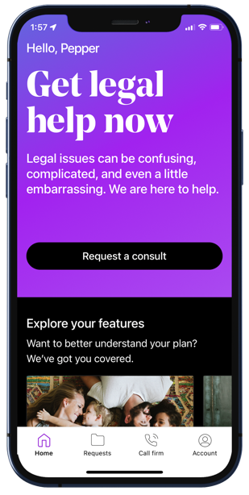
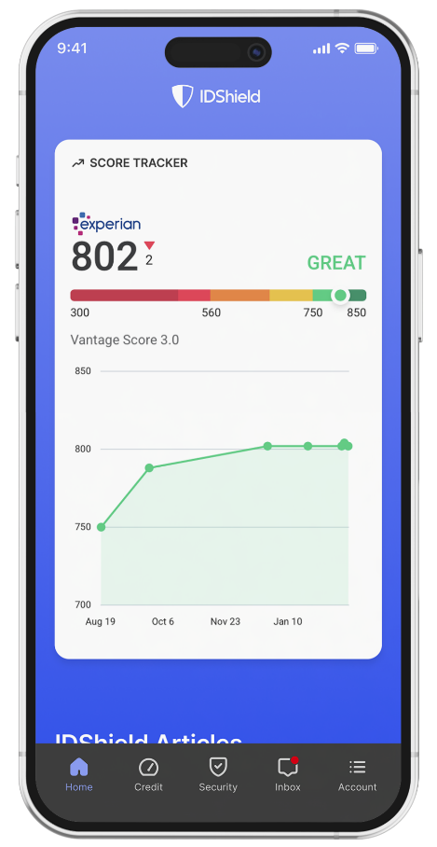
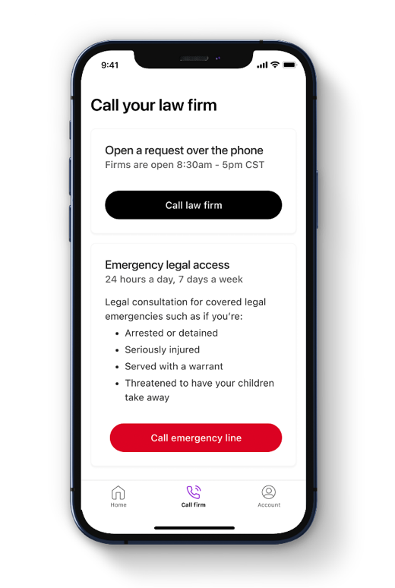




Own Your Own Business
Becoming an Associate: One-time $99
Independence - Work from anywhere
Flexibility - Set your own hours
More Income Opportunities – Linear & Leveraged
Residual income for the lifetime of the membership
Willable book of business
Opportunity to be paid daily
Success system and specialized training
Alignment with a personal mentor
LegalShield Advantage Plus: $24.95/month
1st month is included
Personalized marketing site
Personalized customer enrollment site
Detailed team and commission reports
Opportunity for company incentives
Start Today!
Become a Member
Protect your family!
Protect your small business!
Become an Associate
Position yourself to generate your desired type of income!
Get with your mentor & game plan getting started!

Slide 31
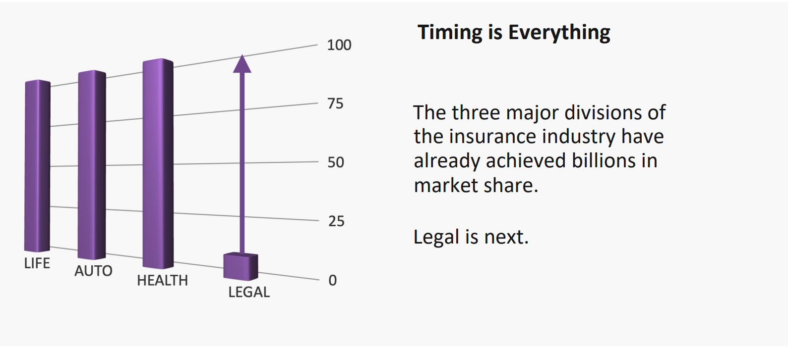
Timing

Slide 32

“So what will I be doing?”
Tomorrow 5pm PST/ 6pm MST/ 7pm CST/ 8pm EST
www.PinnacleZoom.com
Password: 1234

Slide 33
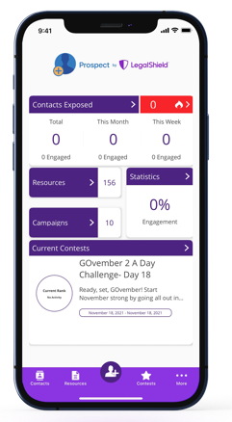
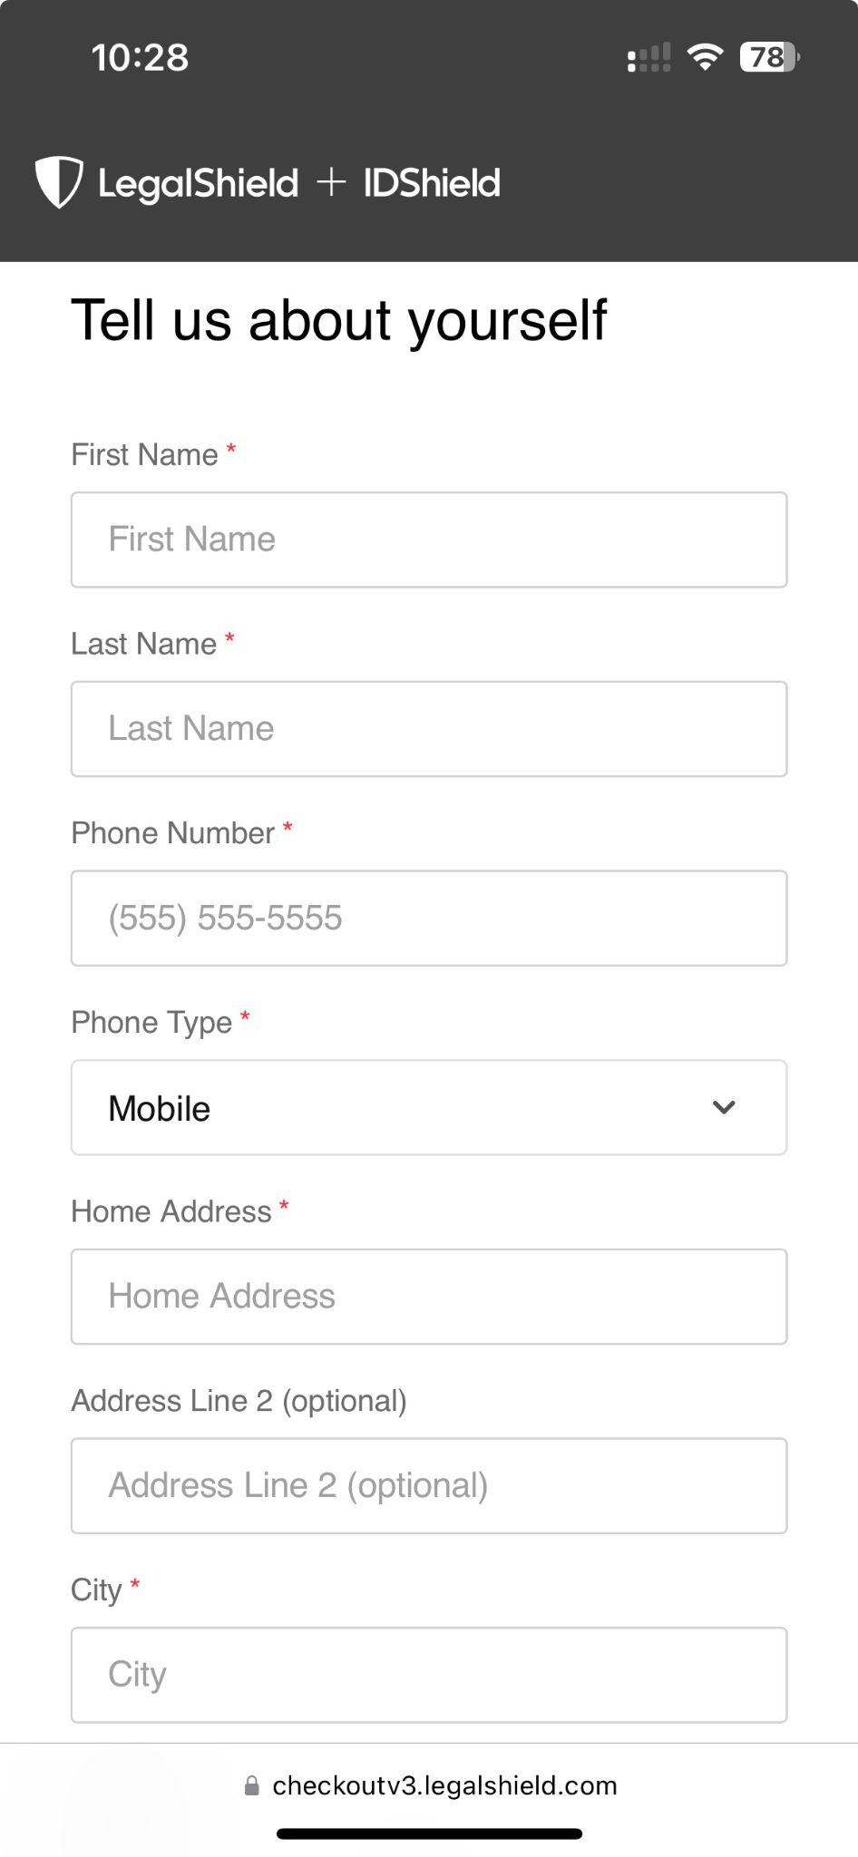
It only takes 3 minutes to enroll!
Getting Started is as Simple as 1, 2, 3!
1
Become a Member
2
Become an Associate
3
Get Trained & Get Paid
The business opportunity information is for use by LegalShield, its affiliates and its independent associates. No guarantee or promise of increased income or business is implied. Individual results and success as an independent sales associate depends on individual effort and abilities. For statistics on actual earnings, please review the Income Disclosure Statement available at opportunity.legalshield.com.

Slide 34
If you see a need and if you can fill that need, and if you could get paid for it, and later you received thank you messages like crazy because you solved people’s problems…
I almost missed this whole thing that impacted me so much.
If you want different, you have to do different.
I decided I did not want to live the working-a-job, check-to-check life. I met entrepreneurs who had what I wanted. And I was willing to take the risk of investing some time each day.
How it feels to be unsure of the future. To not know how you’ll afford retirement. Pandemic caused people to pause and reflect on their life
Jim Rohn - work hard all day at JOB making a living, spare time in evenings building YOUR fortune.
I wouldn’t do anything if I doesn’t have leverage and residual income.
What happens if you get sick…
Plan B .... GAME

Slide 35
“So what will I be doing?”
Sunday 4pm PST/ 5pm MST/ 6pm CST/ 7pm EST
www.PinnacleZoom.com
Password: 1234

Slide 36
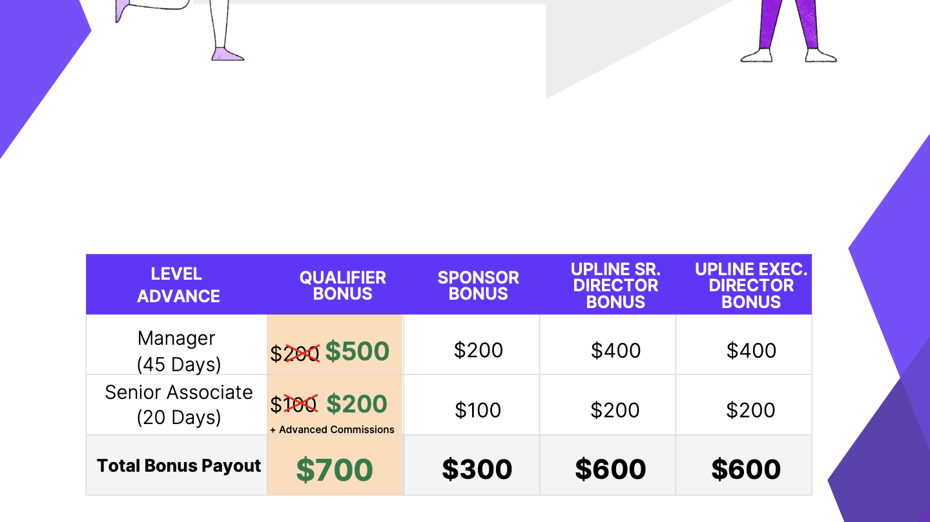

Slide 37


“Tsunami of Legal Issues…”
American Bar – July 2020
Added Value for Your Clients:
Before / During / After the Sale
Homeowner Issues:
~ Estate Planning needed to properly pass property
~ Homeowners Insurance Claims
~ Contracts
~ Contractors – Repairs/Remodeling
~ Warranty Issues – New Appliances, Windows, etc.
~ Mortgage Questions – Refinancing, etc.
~ Neighbor/HOA Disputes
~ Property as Rental or Airbnb
~ Identity Theft Issues
Build a
Bridge
        You know your clients’ HOT BUTTONS!
- Married?
- Children? How old?
- Taking care of elderly family?
- Do for a living?
Door
Opener
Stand Out from Your Competition

Slide 38
This is a general overview of the legal plan coverage available from Pre-Paid Legal Services, Inc. d/b/a LegalShield (“LegalShield”) for illustration purposes only. Trial defense is not available in all states. See a legal plan contract for specific state of residence for complete terms, coverage, amounts and conditions. The business opportunity information is for use by LegalShield, its affiliates and its independentassociates. No guarantee or promise of increased income or business is implied. Individual results and success as an independent sales associate depends on individual effort and abilities. For statistics on actual earnings, please review the income disclosure statement available at www.wearelegalshield.com/income-disclosure.

