Slide 1

The World has Forever Changed
We are in a “work from anywhere” revolution.
Today people are looking for:
More Income
More Time
More Flexibility
Independence
In these uncertain times, doesn’t it make sense to have a backup plan?
1

Slide 2

Are you working for the right kind of income?
3 forms of income
Linear income – trading time for money
Leveraged income – work with team, unlimited income potential
Residual income – your retirement plan

Slide 3
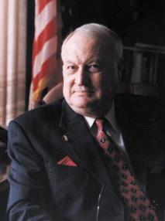






Established in 1972
PROTECTING & EMPOWERING
4.5 million lives with a dedicated network of quality law firms in the U.S. & Canada.
Our Vision
To build a BETTER WORLD where access
to JUSTICE is EQUAL for every human.

Slide 4

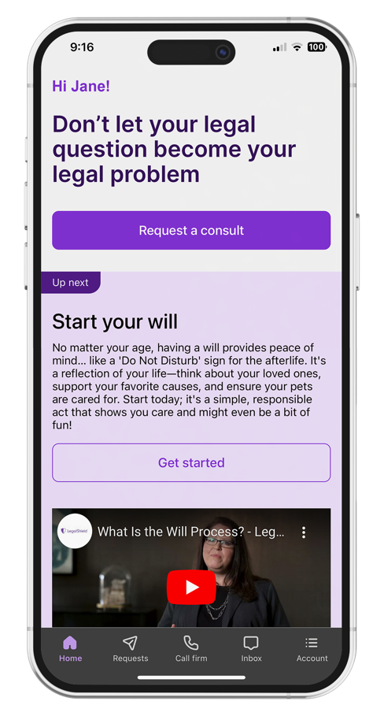
Preferred Legal Plan
Covers member, spouse, and eligible dependent children.
Consultation Unlimited number of personal legal
matters.
Letters or Phone Calls Made on your behalf.
Document Review Unlimited personal legal
documents up to 25 pages each.
Residential Loan Document Review Primary
residence.¹
Residential Tenant Lease Advice, review of
documents and negotiations with a landlord.
Preparation, Annual Reviews and Updates
Will
Durable Power of Attorney
Physician’s Directive/Living Will
Traffic Ticket Assistance Advice and consultation, plus two (2) covered violations per year, per person.²
Property Damage Assistance³
Civil Trial Defense Subject to schedule of hours for covered matters.
IRS Audit Assistance Consultation, audit representation and pre-trial negotiation.
Uncontested
        Minor Child Adoption¹
Name Change
Civil Annulment or Separation or divorce⁴
Prenuptial and Post-nuptial Preparation⁴
24/7 Emergency Access if your rights are being
denied or threatened (for covered emergencies).
Online Notarization Up to (5) per membership year.
E-Signature Unlimited.
25% Discount Off the Provider Law Firm’s standard hourly rate.
This is a general overview of the legal plan coverage available from Pre-Paid Legal Services, Inc. (“PPLSI”) for illustration purposes only. In New York and Nevada an additional fee may be required for some services. See a legal plan details for pre-trial/trial time hours that may apply. Uncontested services have a 180-day waiting period.
1 Primary member and spouse only. 2 $79 fee each time the lawyer makes a court appearance. 10 day waiting period. 3 Can receive when a driver or passenger in or struck by a motor vehicle. Claims $5,000 or less. 4 Primary member only.

Slide 5
Preferred Legal Plan
$39.95 per month - Covers member, spouse, and eligible dependent children.
Consultation Unlimited number of personal legal
matters.
Letters or Phone Calls Made on your behalf.
Document Review Unlimited personal legal
documents up to 25 pages each.
Residential Loan Document Review Primary
residence.¹
Residential Tenant Lease Advice, review of
documents and negotiations with a landlord.
Preparation, Annual Reviews and Updates
Will
Durable Power of Attorney
Physician’s Directive/Living Will
Traffic Ticket Assistance Advice and consultation, plus two (2) covered violations per year, per person.²
Property Damage Assistance³
Civil Trial Defense Subject to schedule of hours for covered matters.
IRS Audit Assistance Consultation, audit representation and pre-trial negotiation.
Uncontested
        Minor Child Adoption¹
Name Change
Civil Annulment or Separation or divorce⁴
Prenuptial and Post-nuptial Preparation⁴
24/7 Emergency Access if your rights are being
denied or threatened (for covered emergencies).
Online Notarization Up to (5) per membership year.
E-Signature Unlimited.
25% Discount Off the Provider Law Firm’s standard hourly rate.
This is a general overview of the legal plan coverage available from Pre-Paid Legal Services, Inc. (“PPLSI”) for illustration purposes only. In New York and Nevada an additional fee may be required for some services. See a legal plan details for pre-trial/trial time hours that may apply. Uncontested services have a 180-day waiting period.
1 Primary member and spouse only. 2 $79 fee each time the lawyer makes a court appearance. 10 day waiting period. 3 Can receive when a driver or passenger in or struck by a motor vehicle. Claims $5,000 or less. 4 Primary member only.

Slide 6
Small Business Legal Plans
Business Benefits | Pro $169 | Plus $99 | Essentials $49
Authorized Users | Up to 5 | Up to 3 | Up to 2
In/Out of State Matters* | Interstate Coverage* | Interstate Coverage* | In State Only
Advice & Consultation | Included* | Included* | Included
Letters/Phone Calls | Up to 40* | Up to 20 * | Up to 10
Document Review | Up to 40 with 25 pages* | Up to 20 with 20 pages* | Up to 10 with 15 pages
Designated Consultation | 5, 30-minute consultations | 5, 30-minute consultations | 3, 30-min consultations
Collection Letters | Up to 15* | Up to 10* | Up to 5
IRS Audit Services | 50 hours | 25 hours | 25% Discount
Employee Handbook Drafting | $500 flat fee, 1 per year | $750 flat fee, 1 per year | 25% Discount
Custom Contract Drafting | $250 each, up to 25 pages | $250 each, up to 25 pages | 25% Discount
Trademark Or Copyright | Legal work of 1 per year | Legal work of 1 per year | 25% Discount
Other Business Legal Work | 25% Discount | 25% Discount | 25% Discount
Trial Defense Supplement add-on | 100 hours - $14.95 | 100 hours - $14.95 | Not applicable
Average hourly rate of a business attorney _______? | $183.95 per month $1.06 per hour, 40 business hours per week | $113.95 per month $.68 per hour, 40 business hours per week | $49 per month $.28 per hour, 40 bus. hours per week

Slide 7
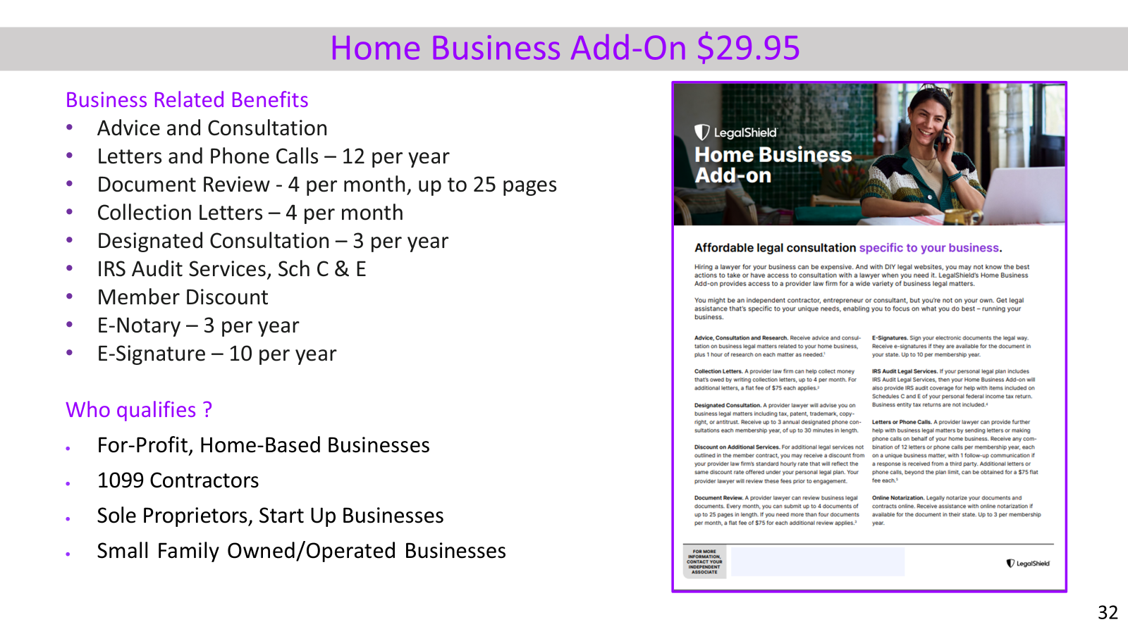

Slide 8
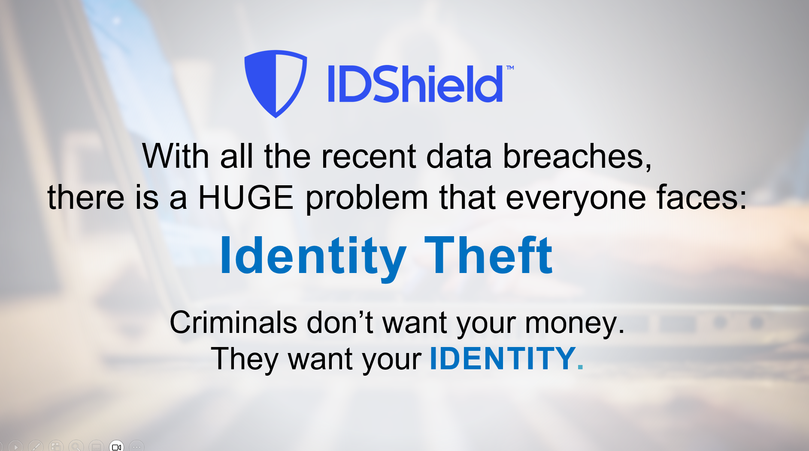

Slide 9

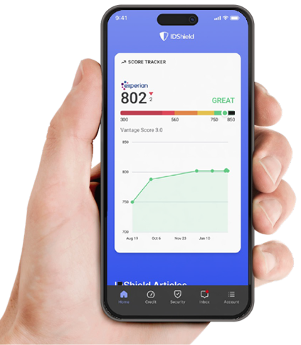
Common types of Identity Theft:
Tax returns
Medical claims
Social Security claims
Credit
Driver’s License
Criminal/Character
You are guilty until proven innocent!
Exclusions and limitations apply. Services and benefits vary by state/province. Please review a contract for complete terms, conditions and exclusions before purchase. IDShield is a product of LegalShield and provides access to identity theft protection and restoration services.

Slide 10

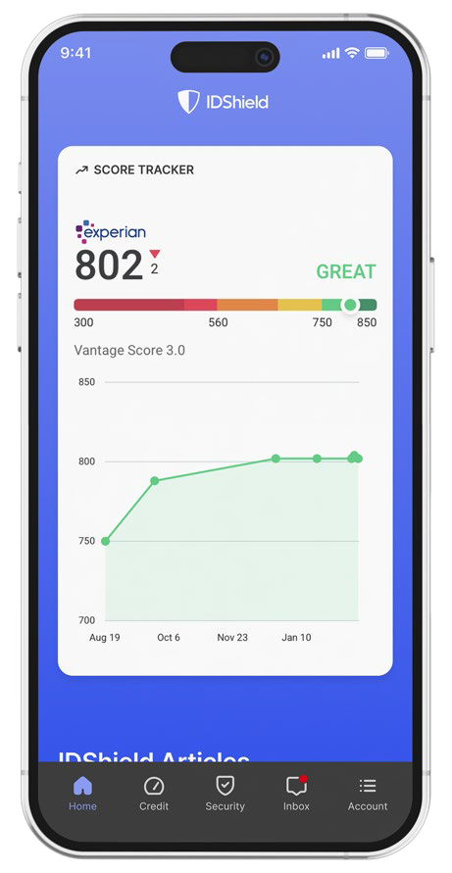

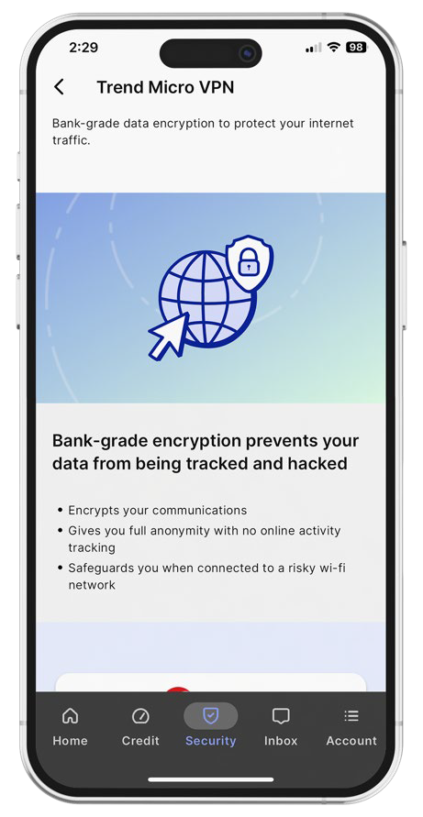
IDShield Plan
Family Plan $34.95 per month with 3 bureau monitoring
Individual Plan $19.95 per month with 3 bureau monitoring
Employee Group Rates available
Credit Score Tracker
Track your Experian credit score each month
Privacy Check
Help keep your information away from data brokers.
Trend Micro Maximum Security
VPN - Turns a public hotspot into a secure Wi-Fi connection.*
Password Manager - Multiple device protection for your digital life.**
Cybersecurity and device protection: We help protect your devices from viruses, malware, and ransomware.*
Reputation Management
Our technology scans certain social media
accounts and Google searches every week
for harmful content.
We can monitor Facebook, Instagram,
LinkedIn YouTube and X (formerly known
as Twitter).
Monitoring & Alerts
Credit Score
SSN, Passport, Driver’s License
Address, Email, Phone, DOB
Court & Public Records
Dark Web & Internet
Social Media
And More!
Financial Threshold Account Monitoring
Receive an alert on financial withdraws, balance transfers & large purchases
Identity Consultation
Identity theft specialists available 24/7 for covered emergencies.
Full-Service Restoration
By licensed private investigators.
$3M Fraud Protection
Up to $3M for covered identity theft-related losses.
Credit Cards
Checking/Savings Account
Retirement Plans
Loans
And More!
Family Plan Covers member and spouse and up to 10 dependent children under the age of 18. Provides consultation and restoration for eligible dependents up to age 26. Individual Plan Covers the member.
*All Licensed Private Investigators are licensed in the state of Oklahoma
*Individual plan covers up to three (3) devices. Family plan covers up to fifteen (15) devices. **Individual plan covers up to one (1) device. Family plan covers up to six (6) devices.

Slide 11
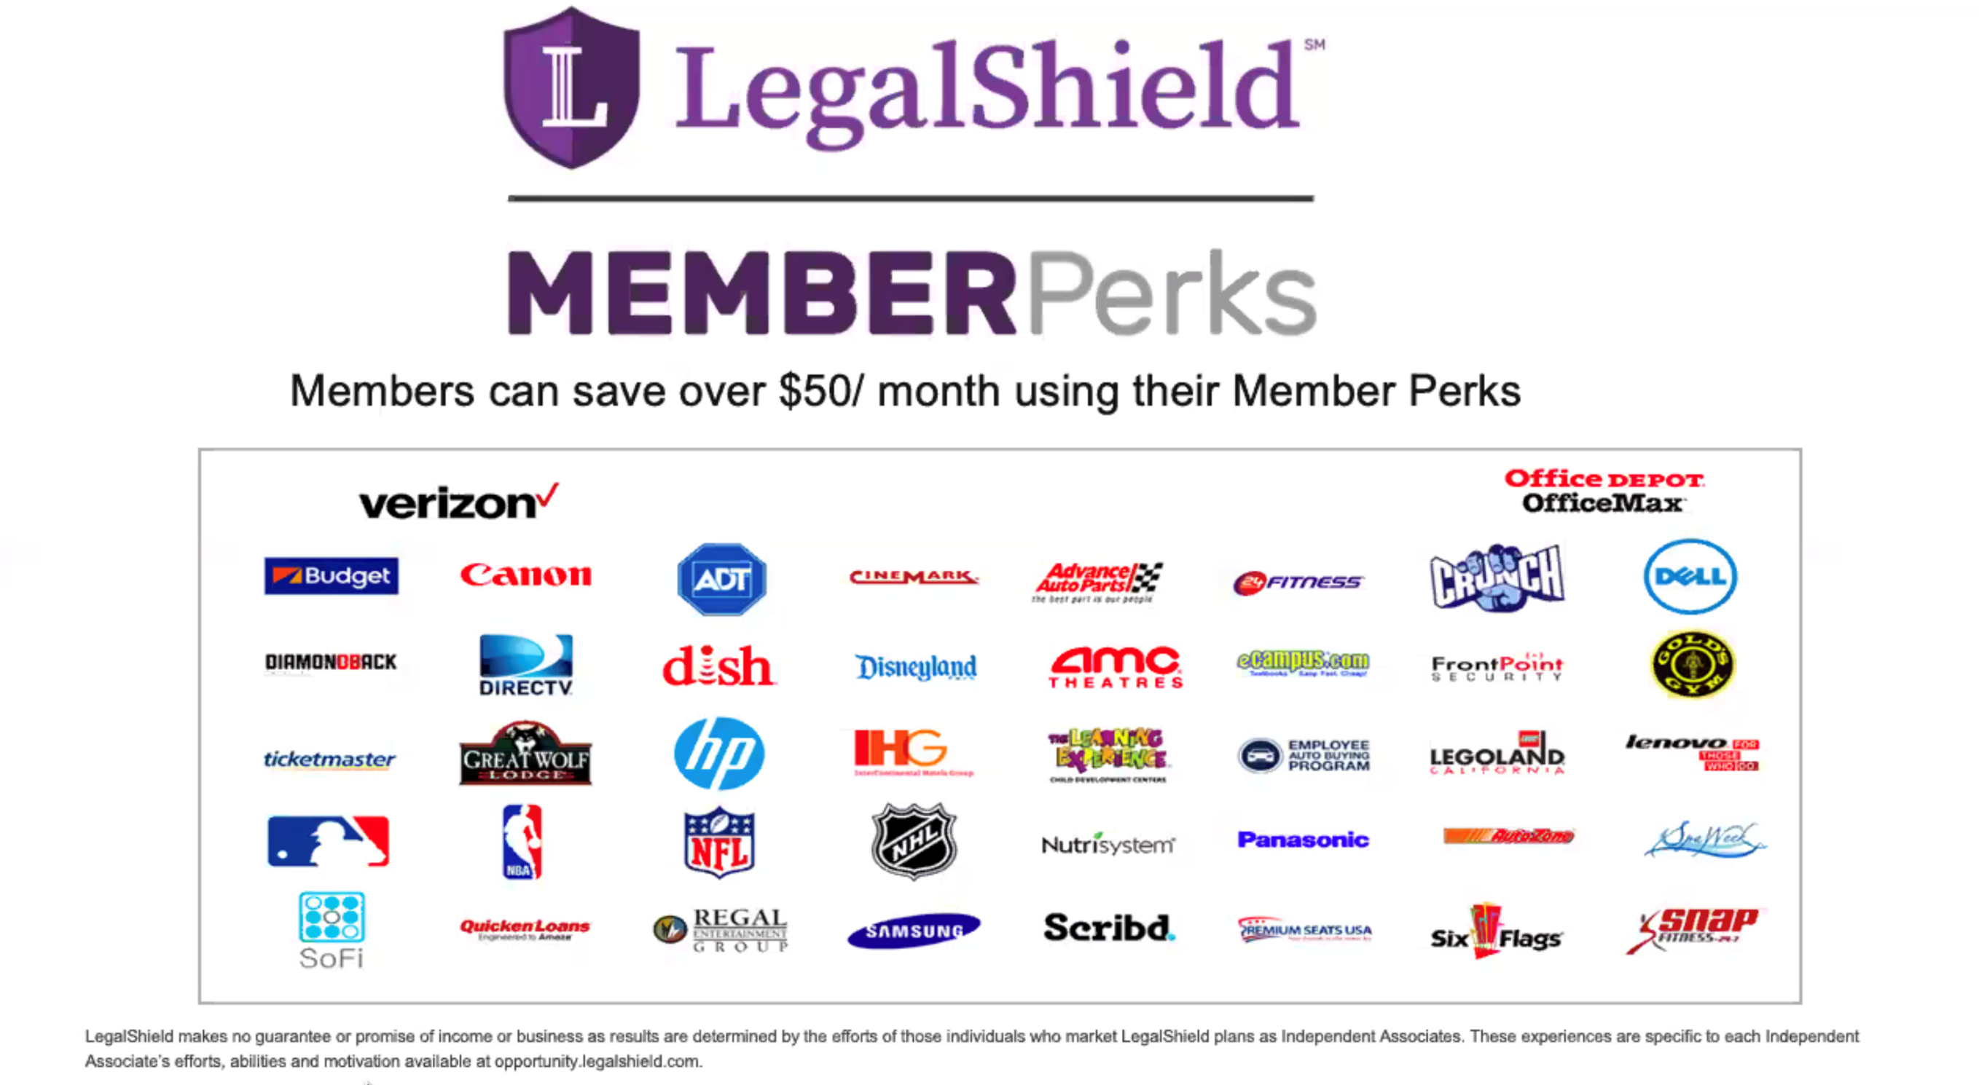

Slide 12

Is this an idea worth sharing?
Help us spread the word

Slide 13




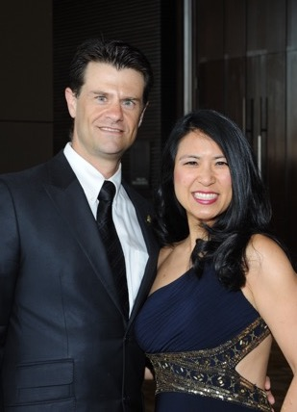
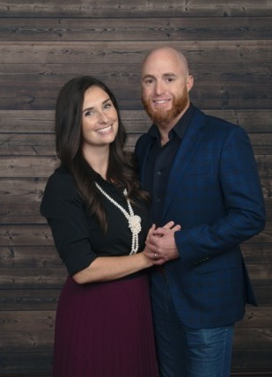
Compensation
Enroll Members
Get paid $82 – $427 per new member.
($80 at associate level up to $416 at Executive Director level)
Leveraged Income
Build a team and earn income on memberships they enroll.
Residual Income
Get paid 10% of commissions again on month 13! Earn commission every month for the lifetime of the membership.
Opportunity to Earn Bonuses
Earn up to $600 in your first 45 days.
Brian & Melissa Carruthers
REAL ESTATE
Darnell & Traci Self
RETAIL
Alex & Julia Shahid
STUDENTS
Anita Sarda
BUSINESS
Liz & David Lequeux
SALES
Daniel & Rebecca Gonzalez
HEALTHCARE
Individual results may vary. Pre-Paid Legal Services, Inc. ("LegalShield") makes no guarantees on income or success. Average 2023 compensation for active LegalShield Independent Sales Associates was approximately $2,647.89 before expenses. There’s a mandatory, one-time $49 registration fee to become an Independent Sales Associate. Optional LegalShield Advantage Plus service available for $24.95/month. This service can be cancelled at anytime. Securing career-level income with LegalShield is not typical and requires sustained hard work and dedication. Please see LegalShield’s Income Disclosure at https://www.pplsi.com/income-disclosure/ for more earnings and expense information.
13

Slide 14
How to earn $1000 this week:
(Assoc --> Sr Assoc) Three $74.90 Legal / IDShield plans + 1 Associate = $246 + FSQ bonus of $200 = $446
(Sr Assoc –> MGR) 2 more Associates with $72.90 combos = $206 + ATM Bonus of $400 = $606
Total Income = $1052
Basically Enroll 5 Customers w/ Combo Package and 3 of them as Associates

Slide 15
Commissions (Based on $39.95 Preferred Legal + $34.95 IDShield)
Your Level
Personal Income
Team Override
Executive Director*
$427
$87 +
Senior Director*
$340
$87 +
Director
$253
$70 +
$345
Bonus
Senior Manager
$183
$47 +
$400¹ (45 Days)
Manager
$136
$33 +
$200² (20 Days)
Senior Associate
$103
$21
¹ Advance to Manager
² Fast Start Qualify
Associate
$82
*Based on Elite Level Commissions
Individual results may vary. Pre-Paid Legal Services, Inc. ("LegalShield") makes no guarantees on income or success. Average 2023 compensation for active LegalShield Independent Sales Associates was approximately $2,647.89 before expenses. There’s a mandatory, one-time $49 registration fee to become an Independent Sales Associate. Optional LegalShield Advantage Plus service available for $24.95/month. This service can be cancelled at anytime. Securing career-level income with LegalShield is not typical and requires sustained hard work and dedication. Please see LegalShield’s Income Disclosure at https://www.pplsi.com/income-disclosure/ for more earnings and expense information.
15

Slide 16
Commissions (Based on 37.95 Legal & 34.95 IDS)
(Based on $169 Pro Biz Plan + 14.95 Trial Defense)
Your Level
Personal Income
Team Override
+ Residual Income
Executive Director*
$427 / $1,048
$87 / $212
Senior Director*
$340 / $836
$87 / $212
Director
$253 / $623
$70 / $170
$345 / $849
Bonus
Senior Manager
$183 / $453
$47 / $113
$400 (45 Days)
Manager
$136 / $340
$33 / $85
$200 (20 Days)
Senior Associate
$103 / $255
$21 / $56
Associate
$82 / $198
*Based on Elite Level Commissions
The business opportunity information is for use by LegalShield, its affiliates and its independent associates. No guarantee or promise of increased income or business is implied. Individual results and success as an independent sales associate depends on individual effort and abilities. For statistics on actual earnings, please review the Income Disclosure Statement available at opportunity.legalshield.com.

Slide 17
The Power of B2B (Employee Benefits)
Land a company with 100 employees,
50 employees enroll
At an average $150 per, that’s $7500
PLUS RESIDUALS

Slide 18
The Power of Part Time
Protect 4 families a month with $74.90 memberships
Earn $320 – $2,164 a month
Teach 25 teammates to do the same
Earn $120,000 per year
(25 teammates x 4 sales = 100 sales x 12 months
= 1,200 sales @ $100 average override)

Slide 19
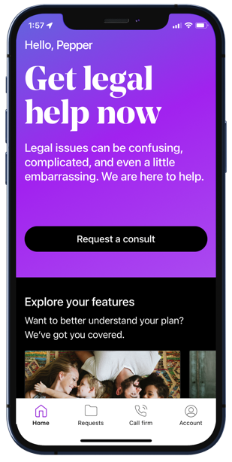
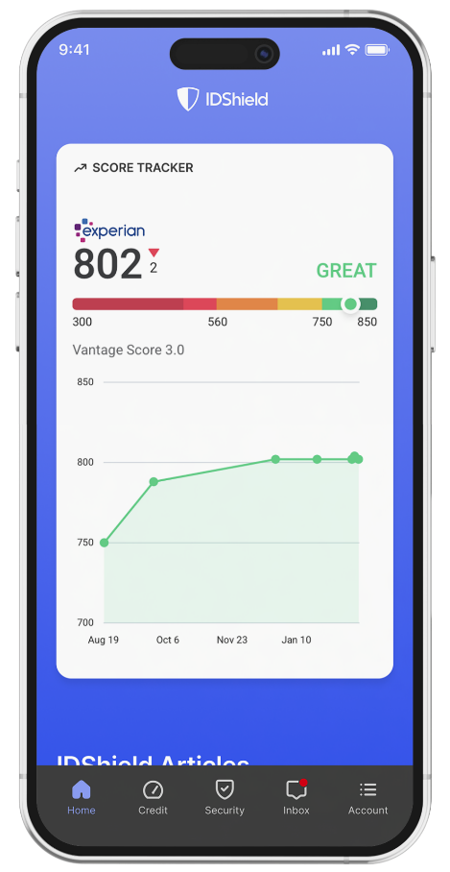
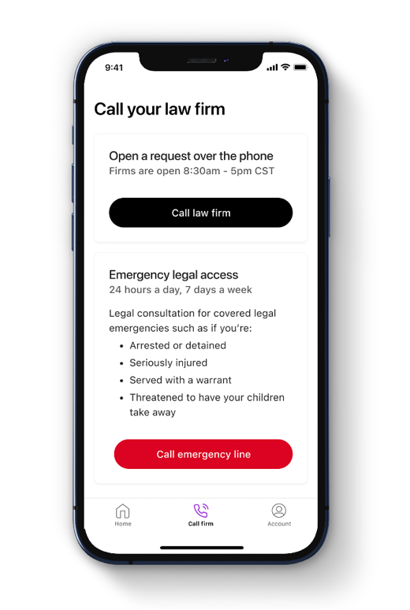




Own Your Own Business
Becoming an Associate: One-time $99
Independence - Work from anywhere
Flexibility - Set your own hours
More Income Opportunities – Linear & Leveraged
Residual income for the lifetime of the membership
Willable book of business
Opportunity to be paid daily
Success system and specialized training
Alignment with a personal mentor
LegalShield Advantage Plus: $24.95/month
1st month is included
Personalized marketing site
Personalized customer enrollment site
Detailed team and commission reports
Opportunity for company incentives
Start Today!
Become a Member
Protect your family!
Protect your small business!
Become an Associate
Position yourself to generate your desired type of income!
Get with your mentor & game plan getting started!

Slide 20

“So what will I be doing?”
Tomorrow 5pm PST/ 6pm MST/ 7pm CST/ 8pm EST
www.PinnacleZoom.com
Password: 1234

Slide 21
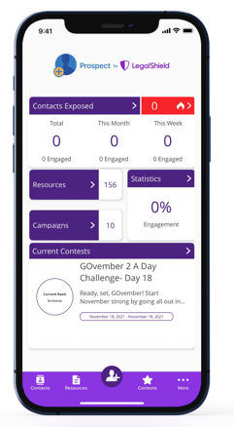
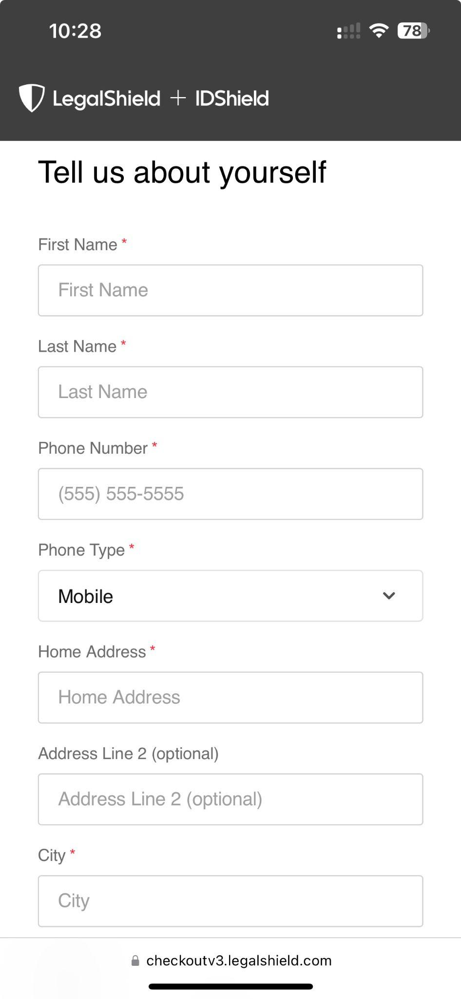
It only takes 3 minutes to enroll!
Getting Started is as Simple as 1, 2, 3!
1
Become a Member
2
Become an Associate
3
Get Trained & Get Paid
The business opportunity information is for use by LegalShield, its affiliates and its independent associates. No guarantee or promise of increased income or business is implied. Individual results and success as an independent sales associate depends on individual effort and abilities. For statistics on actual earnings, please review the Income Disclosure Statement available at opportunity.legalshield.com.

